Slide 1
Infectious Disease Modeling Using Dynamic Compartmental Models in R
SMDM Short Course
22 October 2023
Philadelphia, PA
Notes:
Hello everyone, welcome to the short course on infectious disease modeling.

Slide 2
Conflicts of interest & funding disclaimer
We have no conflicts of interest to declare and no relevant funding to disclose.
Notes:
We have no conflicts of interest to declare or no relevant funding to disclose related to this course.

Slide 3


Acknowledgements
Jason Andrew
Jeremy Goldhaber-Fiebert
Notes:
And we’d like to thank our two previous mentors at Stanford, Jason Andrew and Jeremy Goldhaber-Fiebert who kindly shared their class materials with us

Slide 4


Instructors & introductions
[ADD PHOTOS]
Kyu Lee, PhD
University of Washington
Tess Ryckman, PhD
Johns Hopkins University
Notes:
Before we get started, we’d like to introduce the course intructors. My name is Kyu and I’m an assistant professor of health decision sciences at the CHOICE institute, University of Washington School of Pharmacy. Her research uses simulation models to forecast disease burden and to evaluate health policy impact over a wide range of disease areas. Her recent work focuses on optimizing seasonal influenza vaccine virus selection and forecasting seasonal influenza seasons after COVID-19 pandemic.
(I’ll let you introduce yourself, Tess)
Tess Ryckman, PhD is a faculty member in the Division of Infectious Diseases at the Johns Hopkins School of Medicine. Her research focuses on modeling and cost-effectiveness analysis to inform infectious disease policy and shed light on disease natural history and transmission. She is primarily focused on TB and has a particular interest in prevention and active case finding interventions.
Let’s have a round of introduction with your name, affiliation, and why you are taking this class?

Slide 5
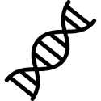


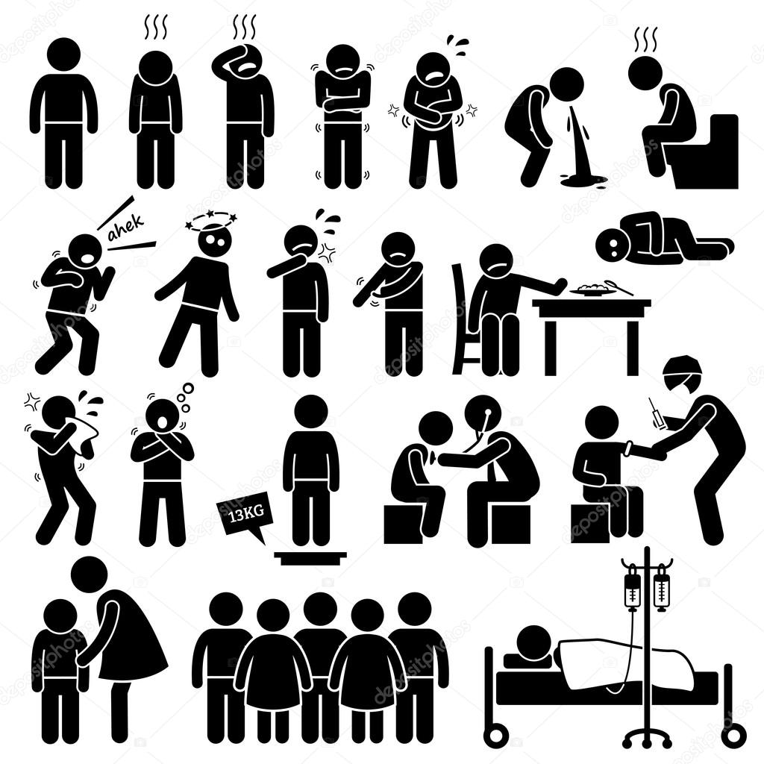


Communicable vs. non-communicable diseases
Notes:
Our goal today is to learn how to build and implement infectious disease models but before we get into the technical part, we can first think about what makes infectious disease distinct from other diseases and why we need a special set of modeling methods?
Human diseases are caused by many factors – behavioral risk factors such as smoking and diet can cause cancers, family history and genetic factors affect early onset of Alzheimer’s disease or cancer. Microorganisms and viruses can be a pathogen for various infectious diseases such as flu and AIDS

Slide 6

Communicable vs. non-communicable diseases
Notes:
Among them, communicable diseases or infectious diseases are different from non-communicable diseases in that the cause of diseases can be transmitted to others through direct or indirect contacts. This means that incidence of disease in an individual affects the risk of developing a disease in others. This distinct nature of infectious disease requires different ways of modeling the disease compared to when we model non-communicable diseases.

Slide 7




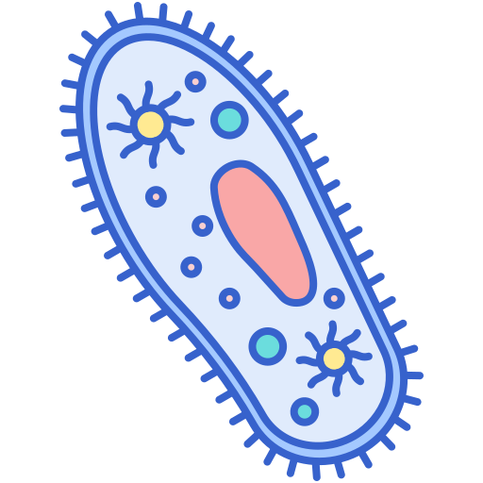
Pathogens that can cause human infectious diseases
Bacteria
Protozoa
Virus
Fungi
Helminths
Tuberculosis
Pneumonia
Gonorrhea
Tetanus
Diptheria
Pertussis
Streptococcal infections
Malaria
Giardia
Trichomoniasis
AIDS/HIV
Influenza
Herpes
Hepatitis
Measles
Mumps
Rubella
Ringworm
Candidiasis
Ascariasis
Trichuriasis
Hookworm
Schistosomiasis
Notes:
Here is a brief overview of pathogens that cause infectious diseases in human and it can be divided into five groups: bacteria, protozoa, virus, fungi, helminths
Bacteria - single-celled microscopic oganism.
Protozoa – a kind of parasite that is microscopic and one-celled organism as well but bigger than bacteria. Giardia (diarrheal disease)
Virus – is different from bacteria in that it can cause infections by entering and multiplying inside the host cells.small and can’t be visible with microscope.
Fungi – cause infections on skin and mucous membranes in mouth, throat, and nails.
Helminth –parasitic worm. also a kind of parasite but large, multicellular organisms that are visible to the naked eyes.
What causes the disease often has an implication on disease pathogenesis, immunity, treatment and prevention.
Figure: https://helalmedical.com/infectious-diseases-classification-and-prevention/

Slide 8
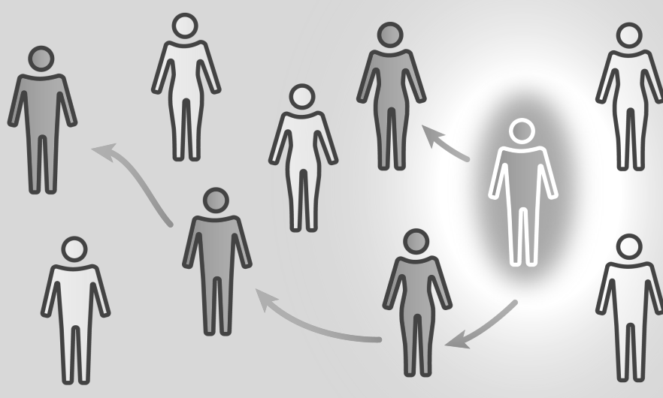

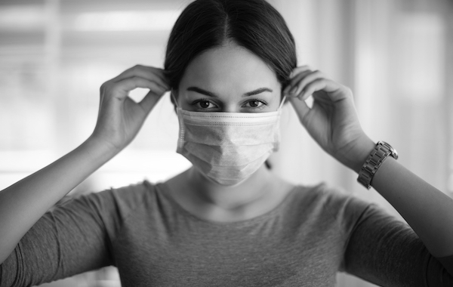

Why model infectious diseases?
Understand the dynamics of infectious disease
Predict the dynamics of infectious disease
Evaluate control measures
Control and Prepare for outbreaks
Notes:
In epidemiology field, mathematical models of infectious disease dynamics are often used for different purposes.
Understand the dynamics of infectious diseases given the available information on epidemiological and biological features of pathogen and population
Predict disease trend under certain scenario – e.g. in pademic, how the dynamic would change as people build immunity over time?
Evaluate control measures – compared the predicted outcomes under different control measures such as vaccination or quarantine
Information generated from the model can inform decision makers to set policies for disease control and resource alocation

Slide 9
Examples of infectious disease modeling for public health
Disease | Modeling study | Scope | Public health impact
2009 A(H1N1) | Fraser C 2009 Garske T 2009 Shaman J 2011 | Pandemic | Quantify transmission Assess severity Assess potential seasonality Support WHO’s decision on timing and targeting of vaccination
Ebola | Chretien JP 2015 Kucharski AJ 2016 Camacho A 2017 | Outbreak | Assess the impact of case isolation, contact-tracing with quarantine, and sanitary funeral practices on the number of new infections Design ring vaccination strategy WHO guideline on designing vaccine efficacy trials
HIV | Granich RM 2009 Bernard C 2017 | Endemic | Introduce the test-and-treat strategy Recommend PrEP for a high-risk group
Kretzschmar M 2020
Notes:
Here are examples where results from modeling studies provided understanding of disease dynamics and supported decisions about control measures.
2009 influenza pandemic – multiple infectious disease modelings were built to understand the scope of pandemic and to assess the seasonal circulation of pandemic strain in the long-term. In addition, models were used to support WHO’s decision on timing and targeting of vaccination to different population group to understand its impact on epidemic peak and duration.
When epidemic of ebola virus disease occurred across western Africa in 2013 to 2016, ebola outbreak models were used to assess potentialoutbreak controlling measures such as case isolation and contact tracing. The model was also used to design a specific vaccination strategy which can effectively control the spread of this highly transmissible disease.
HIV modeling has a long history and they generated evidence prior to introducing interventions. For example, they helped USAID introduce the test and treat strategy and identify a risk group eligible for PrEP to prepare for PrEP guideline.

Slide 10
Multiple ways of modeling infectious diseases
Model type | Time-scale | Feedback allowed | Stochasticity | Modeling unit | Mixing pattern
Discrete-time state transition | Discrete | Yes | No | Population/ subpopulation | Homogeneous
Static compartmental | Continuous | No | No | Population/ subpopulation | Homogeneous
Dynamic compartmental | Continuous | Yes | No | Population/ subpopulation | Homogeneous/ heterogeneous
Microsimulation | Discrete | Yes | Yes | Individual | Homogeneous/ heterogeneous
Network | Discrete | Yes | Yes | Individual/ subpopulation | Homogeneous/ heterogeneous
Agent-based model | Discrete | Yes | Yes | Individual | Homogeneous/ heterogeneous
Notes:
There are multiple ways of modeling infectious diseases depending on the time-scale, whether or not the feedback loop between individual-level incidence and population-level risk, stochasticity, modeling units and mixing pattern. In this class, we are going to focus on dynamic compartmental model which can be simulated on a continuous time scale with feedback from the dynamics allowed. We will briefly introduce other model types when wrapping up.
https://www.ncbi.nlm.nih.gov/pmc/articles/PMC8545442/#:~:text=Furthermore%2C%20discrete%2Dtime%20infectious%20disease,of%20discrete%2Dtime%20disease%20events.
Briefly mention all the possible ways of mdoelingID
WE’re going to focus on a specific form
Will explain why this later

Slide 11
Course aim
To understand the fundamentals of infectious disease epidemiology.
To learn how to construct and parameterize dynamic compartmental models of infectious disease transmission and simulate disease control interventions using R.
To choose an appropriate model structure and set of assumptions for a given use case.
Notes:
Here is what we expect to learn from this class:
We’d like to introduce some fundamental concepts of infectious diseases first and
Learn how to translate those concepts into the dynamic compartment models and simulate the disease transmission and intervention effects using R
After reviewing different model structures within a dynamic compartmental models, we expect to learn how to choose an appropriate model structure and set of assumptiosn for a given use case

Slide 12
Outline
Time | Part | Contents
8:30-8:45 | Introduction & course aim
8:40-9:45 | Part I: Basics and SIR model | Fundamentals of infectious disease epidemiology SIR model as a base model R session #1
 | Part 2: Embellishments to the SIR model | Adding demography Chronic infection Adding heterogeneity R session #2
9:45-10:00 | Break
10:00-10:40 | Part 3: Embellishments to the SIR model | Adding waning/no immunity Adding latent period R session #3 Interventions: vaccine, quarantine, contact tracing R session #4
10:40-11:30 | Exercise (50 mins)
11:30-11:45 | Wrap-up
11:45-12:00 | Q&A
Notes:
No need to mention all the details on the contents. Just mention the overall flow and the fact that we are going to come back and forth between concepts and R session
We are going to start with some basics and SIR model as our baseline
Then we’re going to learn how to add more features to this basic model
Before wrapping up, we have a small exercise to solidify what we’ve learned.
Overall format of the session is that we are going to introduce some relevant concepts in infectious disease epidemiology and talk about how to model them followed by R session.
The class is supposed to be interactive so feel free to stop us if you have any question!
Class: 8:30am - 12:00pm
15 mins break + 15 mins Q&A
Actual lecture time: 3 hrs
Part I + PartII/Tess –resenting slides: 30-35 mins
Part I session: 20 mins (10 mins running code + 10 mins interactive)
Part II/Tess session: 10 mins running code (no interactive session)
<15 mins break>
Part II Slides – 20-25 mins
Part II session – 20 min ( 10 mins running code + 10 mins interactive)
Exercise: 30 minutes
Let's make a detailed outline with how much time needs to be allocated for each for just us

Slide 13
Part I: Basics & the SIR Model
Notes:
TESS START

Slide 14
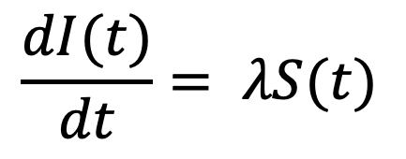
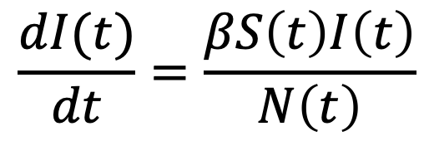
Compartmental models
Population-level models that track individuals according to health states.
Typically governed by series of ordinary differential equations (ODEs).
Dynamic compartmental models allow for “feedback loops”
e.g., Population-level risk of infection increases as more people are infected
Critical for many uses of infectious disease models
Static Compartmental Model
Dynamic Compartmental Model
Susceptible
Infected/Infectious
S
λ
I
S
βI/N
I
N=S+I
$$\frac{dI(t)}{dt}= λS(t)$$
$$\frac{dI(t)}{dt}=\frac{βS\left(t\right)I\left(t\right)}{N\left(t\right)}$$

Slide 15
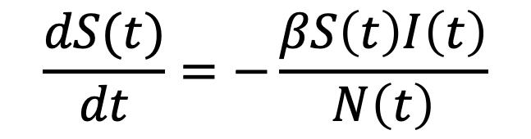
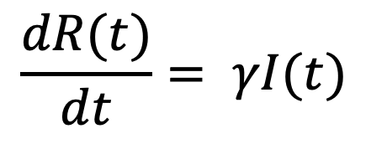
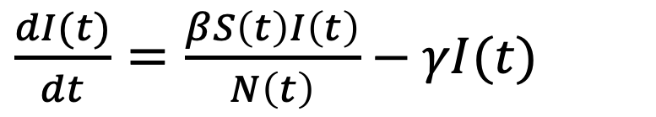
SIR: Susceptible-Infected-Recovered
Today’s model structures will build on the basic SIR model
S
βI/N
I
γ
R
infection
recovery
Recovered individuals are immune
$$\frac{dS(t)}{dt}=−\frac{βS\left(t\right)I\left(t\right)}{N\left(t\right)}$$
$\frac{dI(t)}{dt}=\frac{βS\left(t\right)I\left(t\right)}{N\left(t\right)}$ $−$ $γI(t)$
$$\frac{dR(t)}{dt}= γI(t)$$

Slide 16
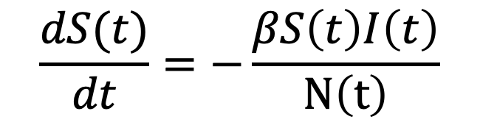
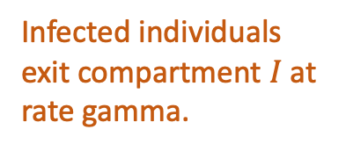
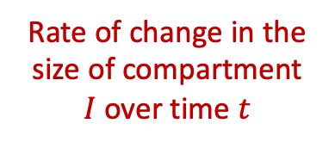
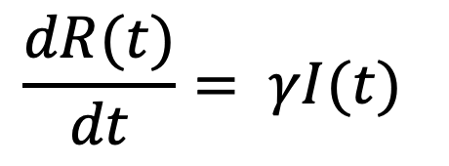
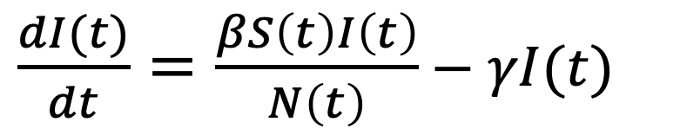
Quick differential equations recap
You don’t need to remember how to solve these equations.
Rate of change in the size of compartment $I$over time $t$
New infections = product of:
susceptible population
% pop infected, and
parameter beta
Infected individuals exit compartment $I$at rate gamma.
$\frac{dI(t)}{dt}=\frac{βS\left(t\right)I\left(t\right)}{N\left(t\right)}$ $−$ $γI(t)$
Beta is known as the “effective contact rate” – we’ll return to beta later.
$$\frac{dS(t)}{dt}=−\frac{βS\left(t\right)I\left(t\right)}{N\left(t\right)}$$
$$\frac{dR(t)}{dt}= γI(t)$$
Notes:
Just want to make sure this makes sense to those of you who might not have encountered differential equations much recently. Occasionally, for simple models, these equations can be solved analytically – but this generally not the case for dynamic models because of the multiplicative terms. In general you’ll use an ODE solver such as deSOLVE in R to numerically approximate the solutions by discretizing what would otherwise be a continuous-time equation – so you don’t need to remember how to solve ODEs for this class.

Slide 17
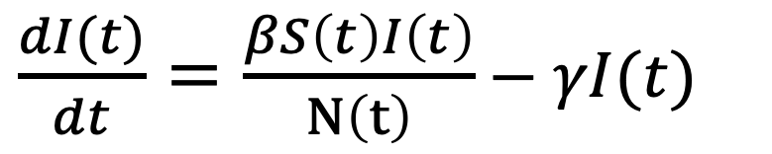
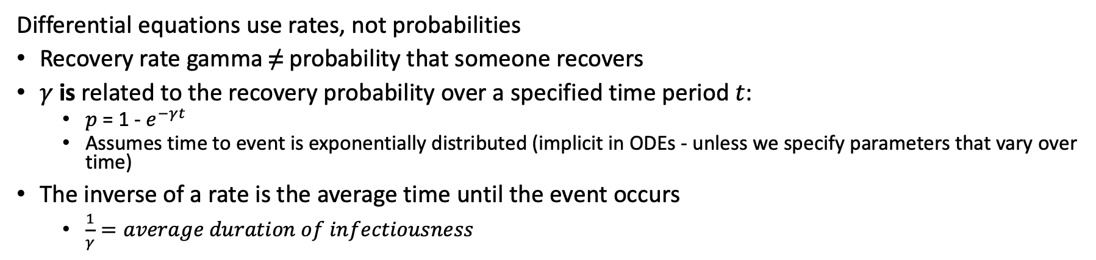
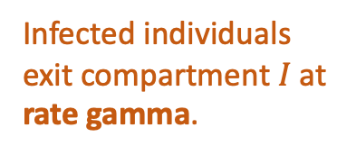
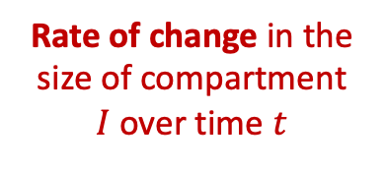
Quick differential equations recap
Rate of change in the size of compartment $I$over time $t$
Infected individuals exit compartment $I$at rate gamma.
$\frac{dI(t)}{dt}=\frac{βS\left(t\right)I\left(t\right)}{N\left(t\right)}$ $−$ $γI(t)$
Differential equations use rates, not probabilities
Recovery rate gamma ≠ probability that someone recovers
$γ$ is related to the recovery probability over a specified time period $t$:
$p$ = 1 - $e^{−γt}$
Assumes time to event is exponentially distributed (implicit in ODEs - unless we specify parameters that vary over time)
The inverse of a rate is the average time until the event occurs
$\frac{1}{γ}=average duration of infectiousness$
Notes:
0.5 -> 39% probability someone recovers in 1 day, 63% probably someone recovers in 2 days, etc. When rates are small – like below 20% ish – the daily rate approximately equals the daily probability.
Mention that ODE can allow for rates that vary over time, in which case time to event would not be exponentially distributed.

Slide 18
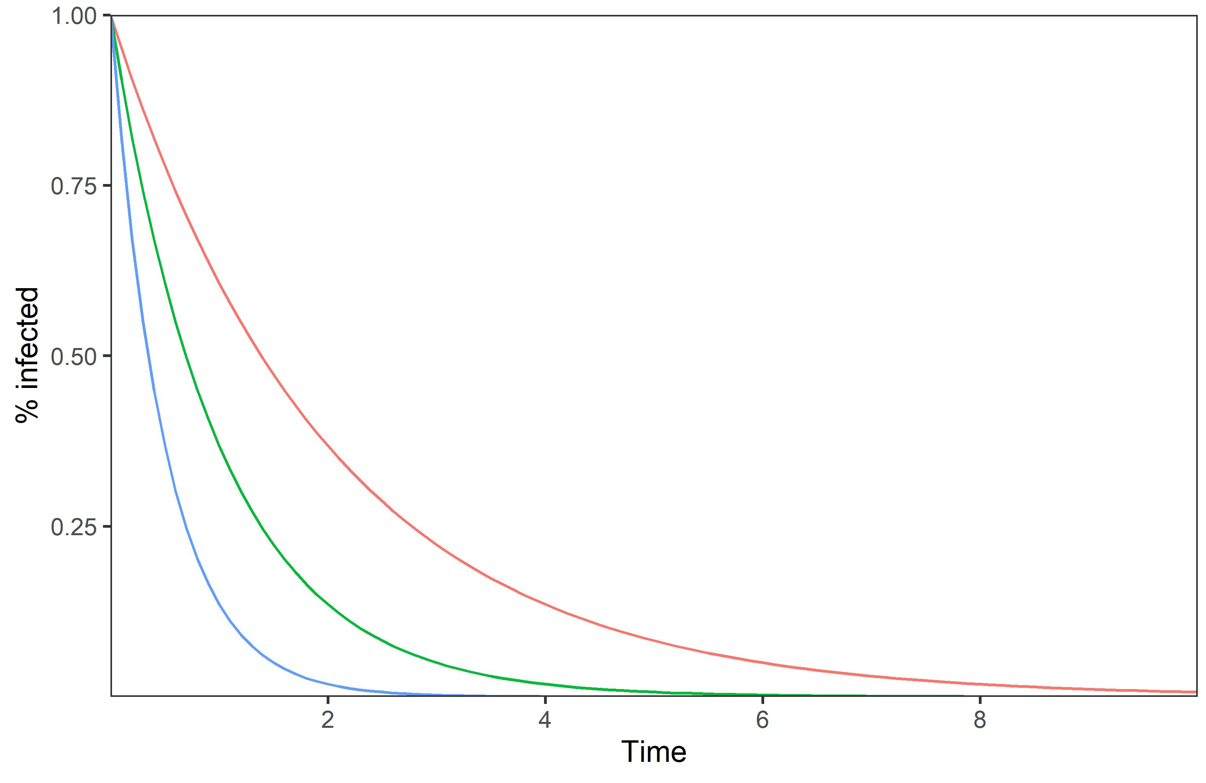
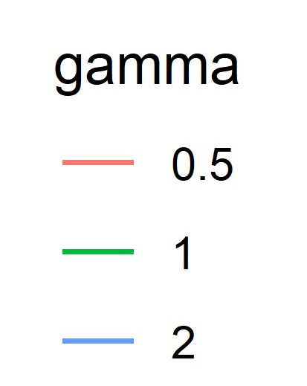
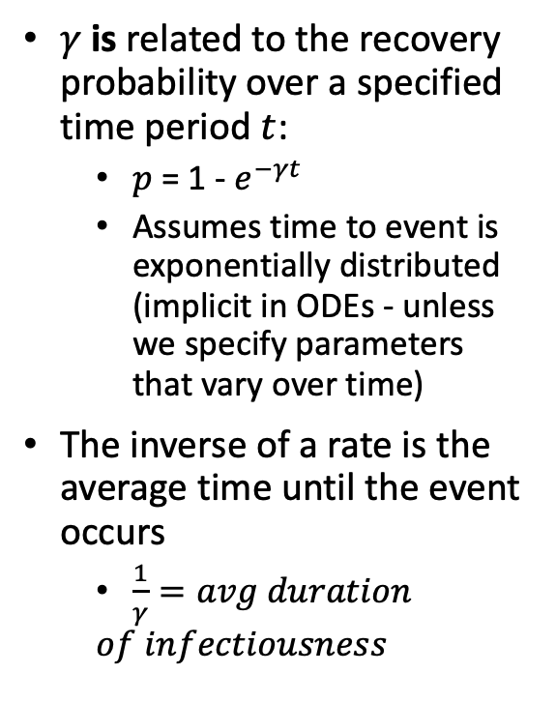
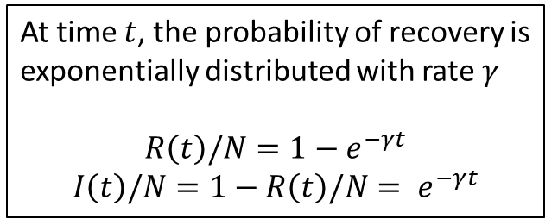
Quick differential equations recap
I
γ
R
$γ$ is related to the recovery probability over a specified time period $t$:
$p$ = 1 - $e^{−γt}$
Assumes time to event is exponentially distributed (implicit in ODEs - unless we specify parameters that vary over time)
The inverse of a rate is the average time until the event occurs
$\frac{1}{γ}=avg duration$
$$of infectiousness$$
At time $t$, the probability of recovery is exponentially distributed with rate $γ$
$$R\left(t\right)/N=1−e^{−γt}$$
$$I\left(t\right)/N={1−R\left(t\right)/N= e}^{−γt}$$
Notes:
This means that, if we turn off entries to the I compartment and just follow and group of infected people over time, the probability that they have recovered by any given point t is characterized by the cumulative distribution function of the exponential distribution. And thus the probability they are still infected equals one minus that CDF. So if we simulated this system over time it would look the same as plotting 1-CDF of the exponential distribution, for any given rate gamma. This is why the avg duration of infectiousness = 1/gamma.

Slide 19
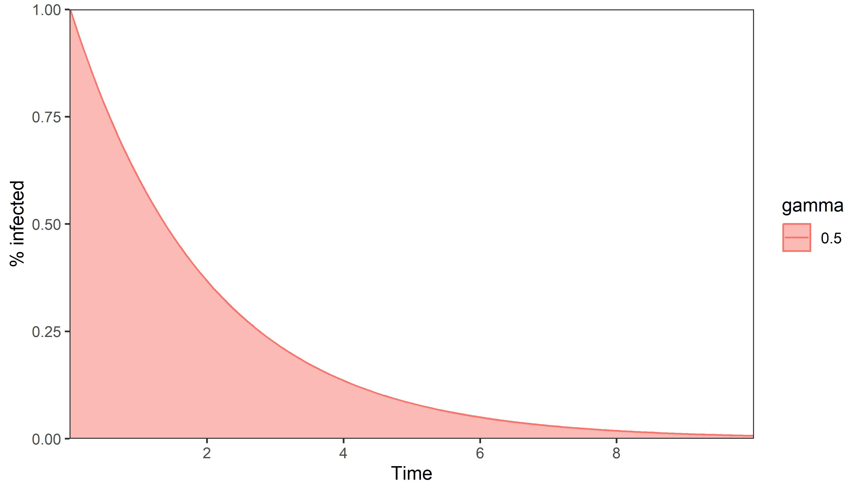
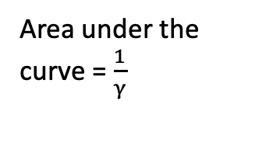
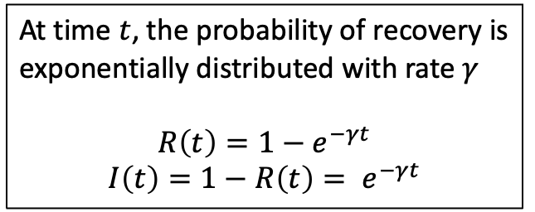
Quick differential equations recap
I
γ
R
$γ$ is related to the recovery probability over a specified time period $t$:
$p$ = 1 - $e^{−γt}$
Assumes time to event is exponentially distributed (implicit in ODEs - unless we specify parameters that vary over time)
The inverse of a rate is the average time until the event occurs
$\frac{1}{γ}=avg duration$
$$of infectiousness$$
Area under the curve = $\frac{1}{γ}$
At time $t$, the probability of recovery is exponentially distributed with rate $γ$
$$R\left(t\right)=1−e^{−γt}$$
$$I\left(t\right)={1−R\left(t\right)= e}^{−γt}$$

Slide 20
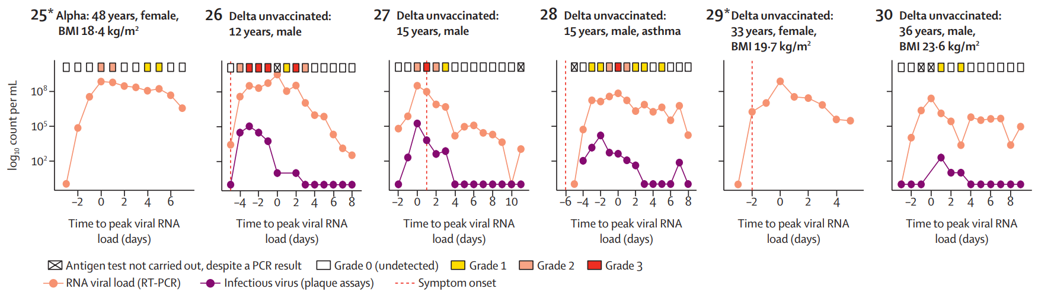
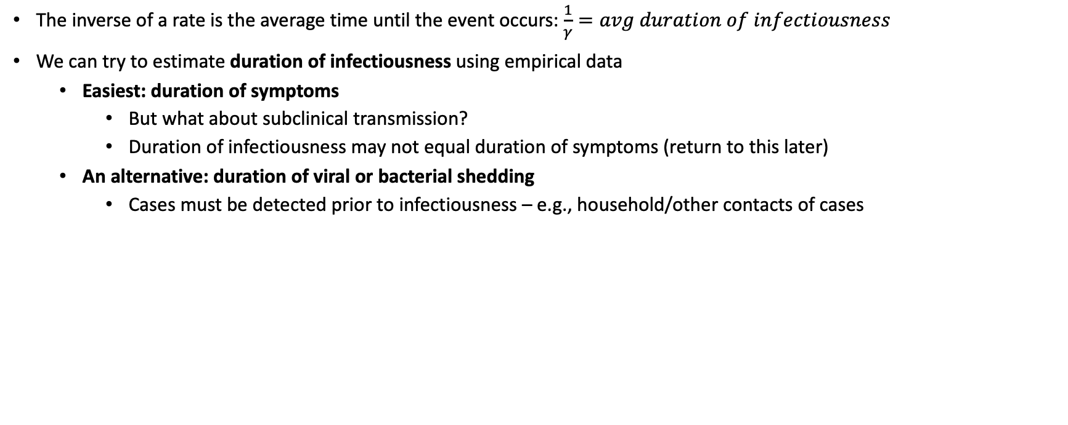
How to estimate the recovery rate
The inverse of a rate is the average time until the event occurs: $\frac{1}{γ}=avg duration of infectiousness$
We can try to estimate duration of infectiousness using empirical data
Easiest: duration of symptoms
But what about subclinical transmission?
Duration of infectiousness may not equal duration of symptoms (return to this later)
An alternative: duration of viral or bacterial shedding
Cases must be detected prior to infectiousness – e.g., household/other contacts of cases
Median duration of infectiousness: 5 [3-7] days.
20% of patients shed infectious virus pre-symptomatically.
Hakki et al. Onset and window of SARS-CoV-2 infectiousness and temporal correlation with symptom onset: a prospective, longitudinal, community cohort study. Lancet Respiratory Medicine 2022.
Notes:
QUESTIONS?
Can anyone think of why we might not want to use duration of symptoms?
This study followed ~700 household and other exposed contacts of people with detected SARS-CoV-2. 57 of those people developed COVID and were followed for long enough to be included in this analysis, which included daily PCR testing, antigen testing, and symptom screening. PCR was used to quantify RNA viral load and plaque-forming units – both metrics thought to be correlated with infectiousness. Median duration of infectiousness was 5 days, 20% shed infectious virus (plaque forming units) before symptom onset.
Contrast the example of COVID with the example of TB – where people can take months or years to become infectious after being exposed, and when detected, people need to be treated, which renders them uninfectious fairly quickly. As a result of these challenges, we have really poor estimates of the average time people spend with infectious TB.

Slide 21
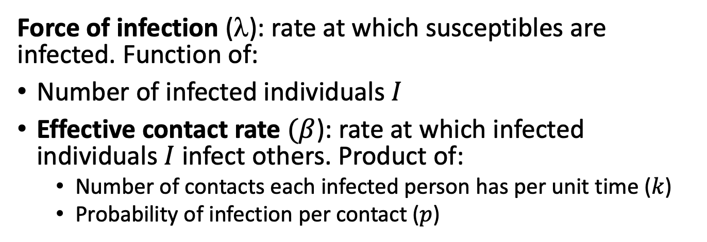
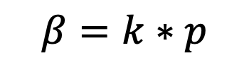
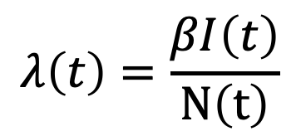
Effective contact rate & force of infection
Static Compartmental Model
Dynamic Compartmental Model
S
λ
I
S
βI/N
I
Force of infection (λ): rate at which susceptibles are infected. Function of:
Number of infected individuals $I$
Effective contact rate $(β$): rate at which infected individuals $I$ infect others. Product of:
Number of contacts each infected person has per unit time ($k$)
Probability of infection per contact ($p$)
$$λ\left(t\right)=\frac{βI\left(t\right)}{N\left(t\right)}$$
$$β=k∗p$$
Notes:
Everytime I say number, this can also be just the proportion of the population. Sometimes people or papers will talk about the “transmission rate” and I’ve seen that used to refer to both beta and lambda.

Slide 22

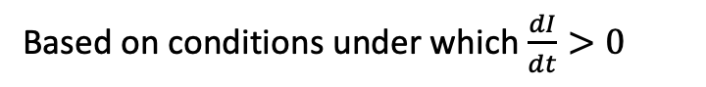
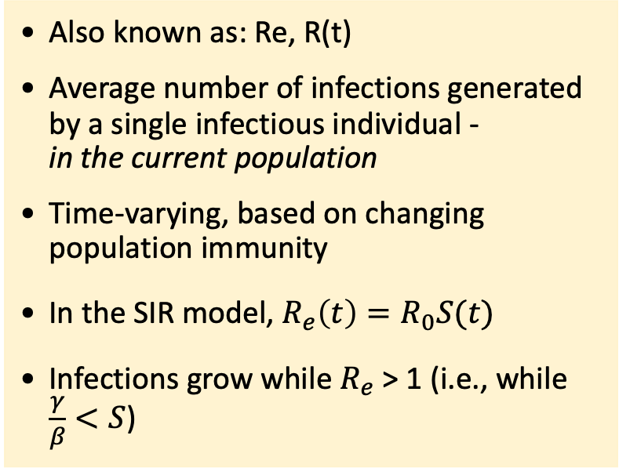
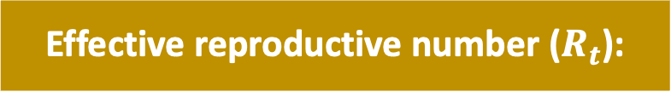
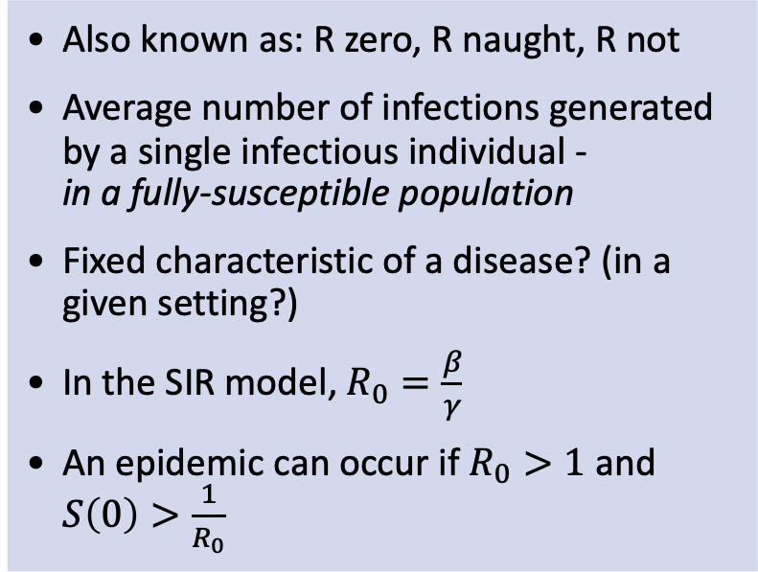
Reproductive numbers
Basic reproductive number ($R_{0}$):
Effective reproductive number ($R_{t}$):
Also known as: R zero, R naught, R not
Average number of infections generated by a single infectious individual - in a fully-susceptible population
Fixed characteristic of a disease? (in a given setting?)
In the SIR model, $R_{0}=\frac{β}{γ}$
An epidemic can occur if $R_{0}>1$ and $S\left(0\right)>\frac{1}{R_{0}}$
Also known as: Re, R(t)
Average number of infections generated by a single infectious individual - in the current population
Time-varying, based on changing population immunity
In the SIR model, $R_{e}\left(t\right)=R_{0}S(t)$
Infections grow while $R_{e}$ > 1 (i.e., while $\frac{γ}{β}<S$)
Based on conditions under which $\frac{dI}{dt}>0$
Notes:
We can also try to estimate beta through it’s relationship with the basic reproductive number, R0.
R0 is an important concept in ID epi more broadly. Can help characterize system dynamics.
Does anyone want to define 1 of these 2 concepts or tell me the main difference between them?
In a given setting because R0 depends on the effective contact rate, which can vary if, say, population contact patterns change – for instance in response to a global pandemic.
Why are these different? Herd immunity

Slide 23
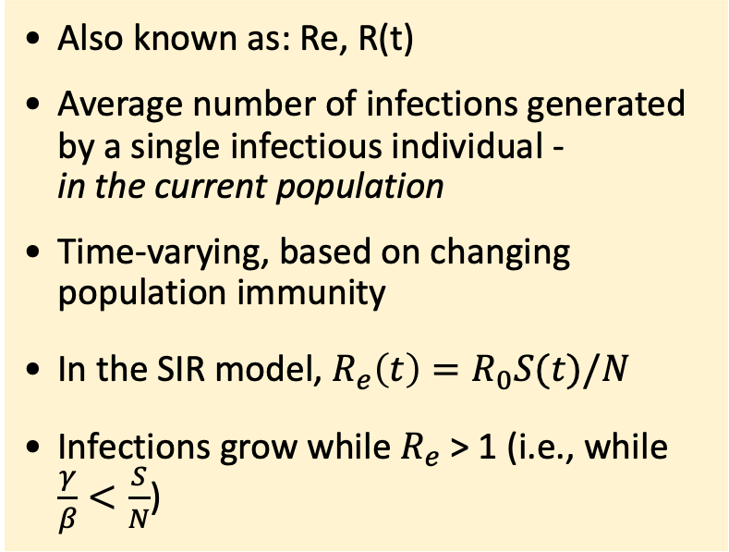
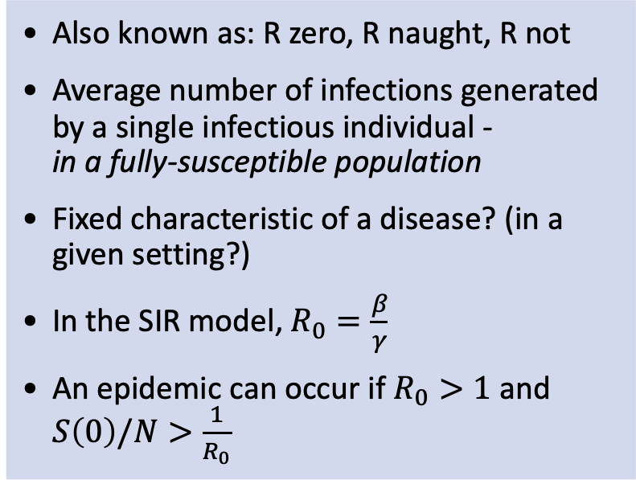
Reproductive numbers
Basic reproductive number ($R_{0}$):
Effective reproductive number ($R_{t}$):
Also known as: R zero, R naught, R not
Average number of infections generated by a single infectious individual - in a fully-susceptible population
Fixed characteristic of a disease? (in a given setting?)
In the SIR model, $R_{0}=\frac{β}{γ}$
An epidemic can occur if $R_{0}>1$ and $S\left(0\right)/N>\frac{1}{R_{0}}$
Also known as: Re, R(t)
Average number of infections generated by a single infectious individual - in the current population
Time-varying, based on changing population immunity
In the SIR model, $R_{e}\left(t\right)=R_{0}S(t)/N$
Infections grow while $R_{e}$ > 1 (i.e., while $\frac{γ}{β}<\frac{S}{N}$)
Based on conditions under which $\frac{dI}{dt}>0$
Notes:
We can also try to estimate beta through it’s relationship with the basic reproductive number, R0.
R0 is an important concept in ID epi more broadly. Can help characterize system dynamics.
Does anyone want to define 1 of these 2 concepts or tell me the main difference between them?
In a given setting because R0 depends on the effective contact rate, which can vary if, say, population contact patterns change – for instance in response to a global pandemic.
Why are these different? Herd immunity

Slide 24
R₀ estimates for various diseases
Disease | R₀ Estimates/Range | Sources (mostly systematic reviews)
Tuberculosis | < 1 to 4 | Ma et al. Epidemiology & Infection 2018
Monkeypox (2022-23) | < 1 to 3 | Banuet-Martinez et al. Epidemiology & Infection 2023.
Ebola (2014 outbreak) | 1.3-1.8 | Wong et al. Epidemiology & Infection 2017.
Seasonal Influenza | 1-2 | Chowell, Miller, & Viboud, Epidemiology & Infection 2008
COVID-19 (“ancestral”) | 2-5 | Billah et al. PLOS ONE 2020.
Pertussis | 5-6 | Kretzschmar et al. PLOS Med. 2010
Mumps, Rubella, Varicella generally in this range
Measles | 12-18 | Guerra et al. Lancet ID 2017
Caveats:
R₀ can be setting-specific but still informative
Methods vary across studies
Viruses (and bacteria) evolve
As outbreaks unfold, or for endemic diseases, we might care more about R_{e} than R₀
Notes:
Lots of these citations are systematic reviews, which to some extent addresses some variation across methods and settings.
Explain why we care about R0 (especially at the beginning of an epidemic) and then Rt (later)

Slide 25
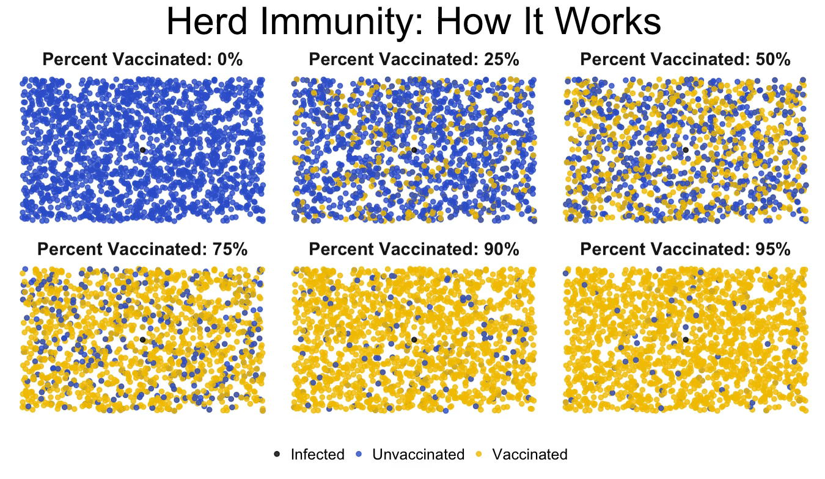
Herd immunity
Population susceptibility is the limiting factor in epidemics - dictating whether they start & when they end
https://imgur.com/gallery/cKsG0
Notes:
We’ll return to vaccines later in this course, but for now think of yellows as being anyone protected/immune through any means. In our simulations with this basic SIR model, outbreaks end because there aren’t enough susceptible people that can be infected – but the level of immunity that is sufficient to end an outbreak is easier to hit for diseases with a lower R0.

Slide 26
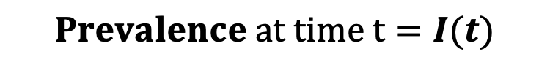
Incidence & prevalence
In this diagram, what corresponds to prevalence and/or incidence?
$Annual incidence from t_{0}to t_{1}=\frac{βS\left(t_{0}\right)I\left(t_{0}\right)}{N\left(t_{0}\right)}$where beta is an annual rate
$$Prevalence at time t=I(t)$$
S
βI/N
I
R
infection
recovery

Slide 27
R Session #1: Setting up & running an SIR model
What do we need?
Code and packages
Main package: deSolve (ODE solver in R)
Code is provided – we’ll walk through it together
Parameter values – typically calibrated
Effective contact rate (beta): can be informed by empirical data on R₀
Recovery rate (gamma): can be informed by empirical data on duration of infectiousness
Starting population sizes
New disease/outbreak: “seed” 1 infected person, everyone starts out susceptible
Endemic disease: “burn in” model for several timesteps until it reaches a steady state (that should match empirical data, e.g., on prevalence or seroprevalence)
We’ll return to this in part 2
Notes:
Survey if people are familiar with using R.

Slide 28
R Session #1: Introductory SIR model
Demo:
How to set up and run the SIR model in R and visualize model output
How to calculate R0 and Rt from model parameters and output
How does Rt characterize infection dynamics over time?
On your own:
Try running the code that we went through together yourself
Check that you understand what is happening in the code, ask questions!
Assess how infection dynamics change as the two parameters in the SIR model – effective contact rate (beta) and recovery rate (gamma) – vary
Can you compare these changes in infection dynamics to changes in R0?
We’ve provided some starter code

Slide 29
Part 2: Embellishments to the SIR Model

Slide 30
Some limitations of the basic SIR model:
Epidemic always burns through the population eventually
Most infectious diseases carry mortality risks (which can alter dynamics)
Assumes completely homogeneous population
Immunity isn’t usually lifelong
Infected ≠ infectious (not always)
Durations are not always exponentially-distributed
Doesn’t always accommodate interventions
Notes:
The basic SIR model is pretty unrealistic – and this slide describes some reasons why. We’re going to talk about adjustments we can make to the SIR model, still using this dynamic compartmental modeling framework, that will overcome these limitations. The first is one we encountered in the R sessions just now – we know that lots of infectious diseases are endemic, and continuously spreading (not huge outbreaks that quickly die out) – but endemicity is not really possible with the basic SIR model.
Can anybody think of changes we could make that would allow a disease to become endemic?

Slide 31
Adding demography: SIR w/ births & deaths
Motivation:
From Part 1: Population susceptibility is the limiting factor in epidemics - dictating whether they start & when they end.
→ models that don’t allow for replenishment of susceptibles will always predict that epidemics burn out eventually.
Incorporating births and deaths allows for more realistic disease dynamics, including endemicity.

Slide 32
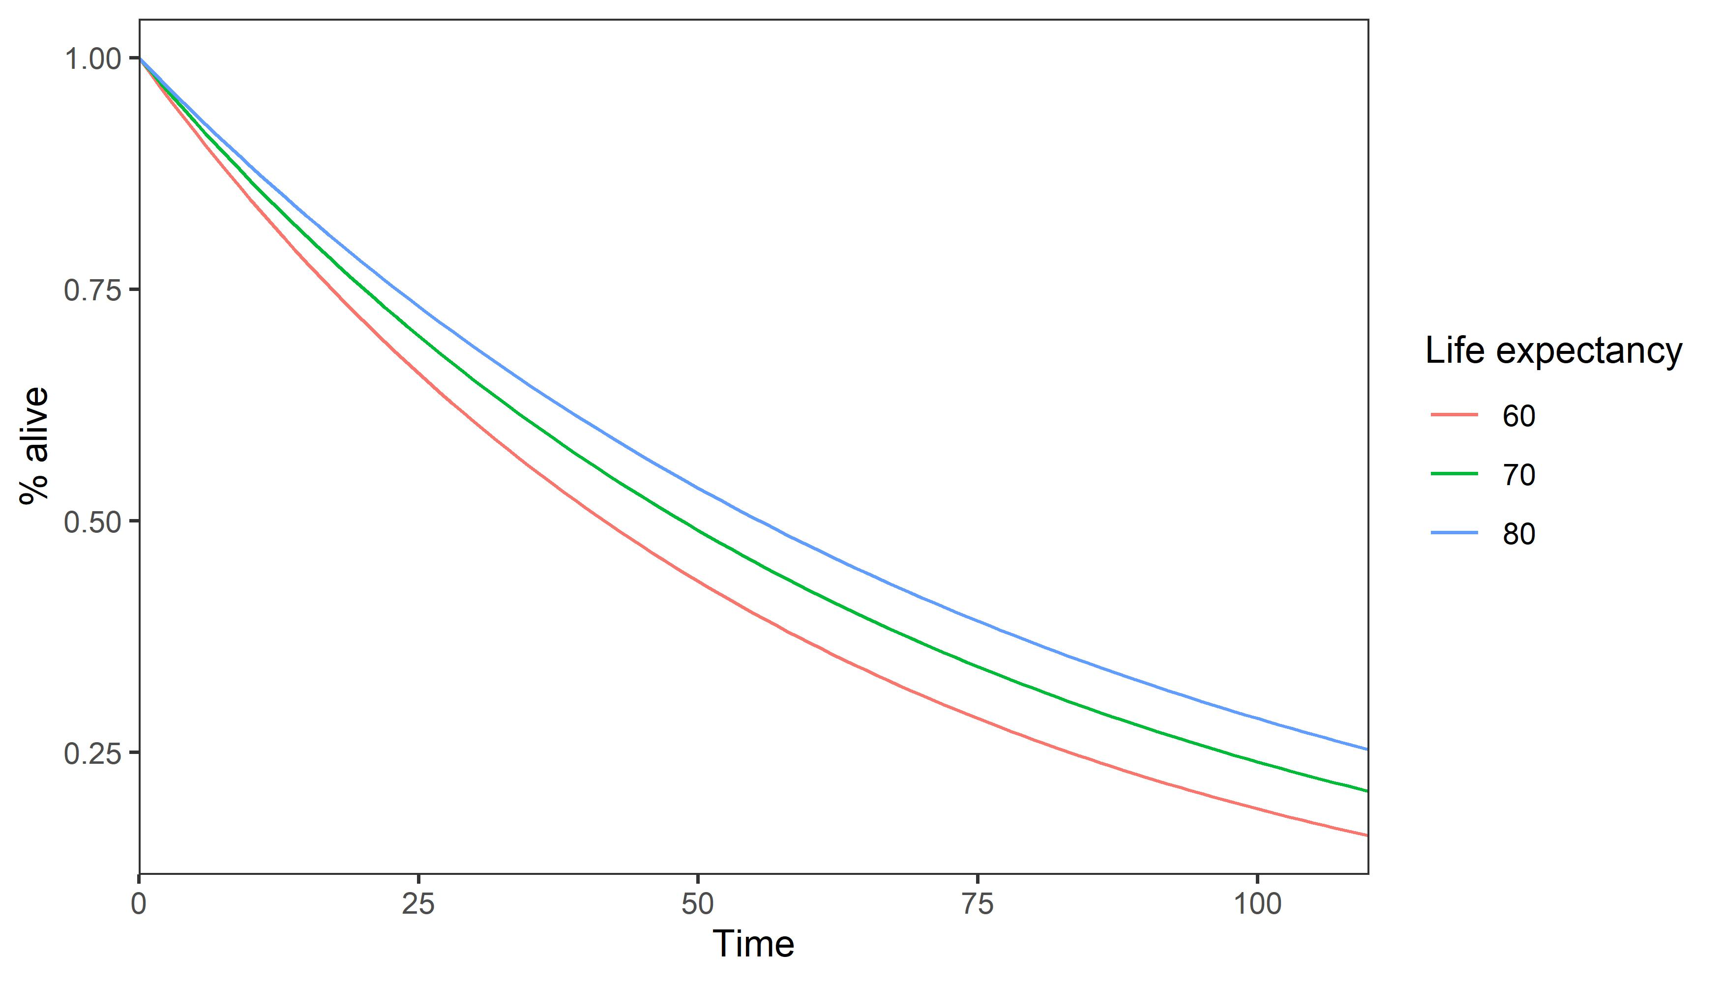

Adding demography: SIR w/ births & deaths
First consider modeling demography outside of an ID model.
N
$$d$$
outflows = deaths

Slide 33
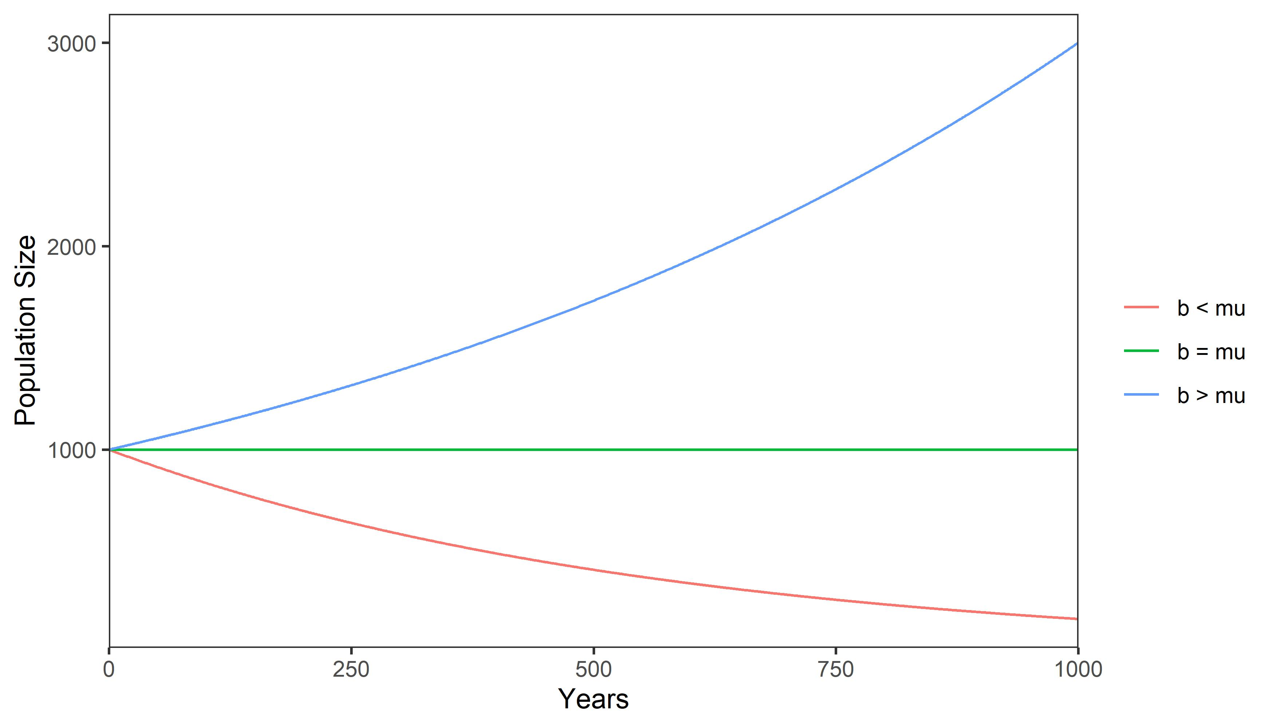

Adding demography: SIR w/ births & deaths
First consider modeling demography outside of an ID model.
$$b$$
inflows = births
N
d
d
d
$$d$$
outflows = deaths

Slide 34
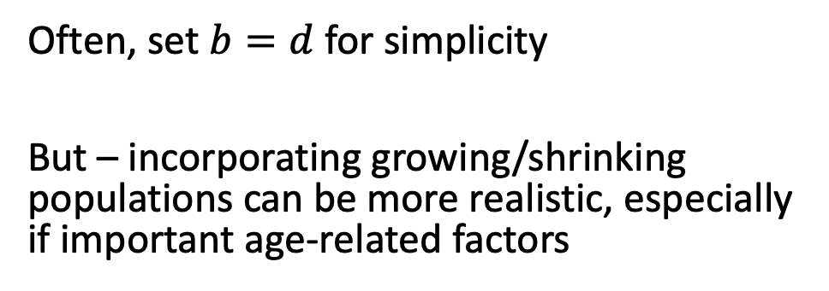

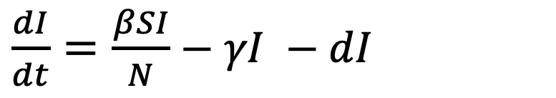

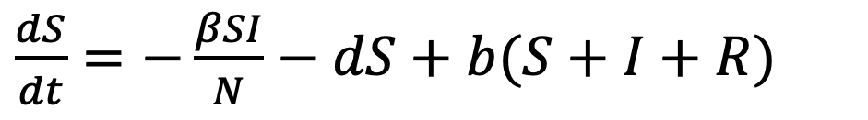
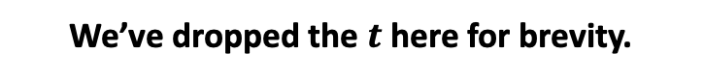

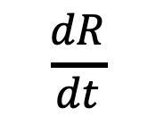


Adding demography: SIR w/ births & deaths
We’ve dropped the $t$ here for brevity.
Now let’s consider adding demographics to our SIR model.
S
βI/N
I
γ
R
$$b$$
Everyone starts out susceptible
$$d$$
$$d$$
No disease-specific mortality for now
$$d$$
$\frac{dS}{dt}=−\frac{βSI}{N}−dS+b(S+I+R)$
Often, set $b=d$ for simplicity
But – incorporating growing/shrinking populations can be more realistic, especially if important age-related factors
$\frac{dI}{dt}=\frac{βSI}{N}−$ $γI −dI$
$$\frac{dR}{dt}$$
$$=γI −dR$$

Slide 35
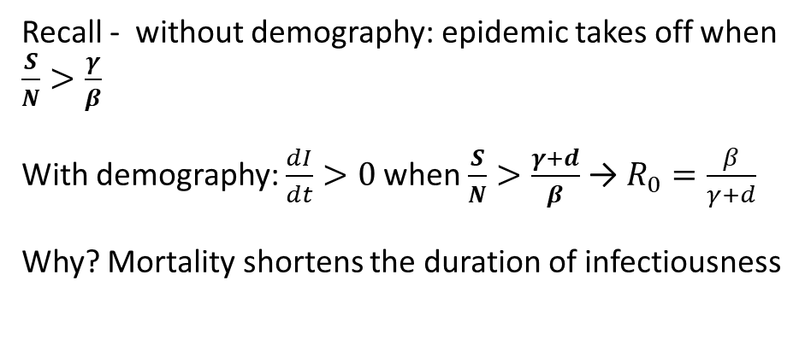
Adding demography: SIR w/ births & deaths
Now let’s consider adding demographics to our SIR model.
S
βI/N
I
γ
R
$$b$$
$$d$$
$$d$$
$$d$$
$\frac{dS}{dt}=−\frac{βSI}{N}−dS+b(S+I+R)$
Recall - without demography: epidemic takes off when $\frac{S}{N}>\frac{γ}{β}$
With demography: $\frac{dI}{dt}>0$when $\frac{S}{N}>\frac{γ+d}{β}$ → $R_{0}=\frac{β}{γ+d}$
Why? Mortality shortens the duration of infectiousness
$\frac{dI}{dt}=\frac{βSI}{N}−$ $γI −dI$
$$\frac{dR}{dt}$$
$$=γI −dR$$
Notes:
So there is a stricter threshold for when the epidemic takes off, and R0 is smaller for a given beta and gamma. Can you think of why this might be?

Slide 36
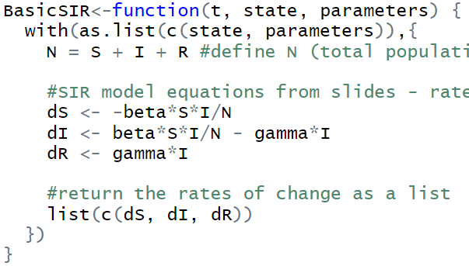
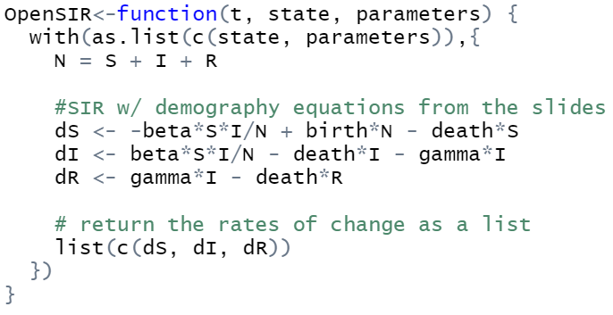
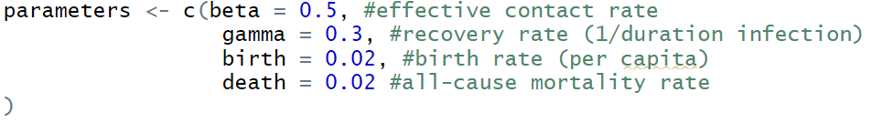
SIR with demography: R code
SIR without demography
SIR with demography

Slide 37



Adding demography: SIR w/ births & deaths
Incorporating disease-specific mortality
S
βI/N
I
γ
R
$$b$$
$$d$$
$$d+d_{I}$$
$$d$$
$$d$$
$\frac{dS}{dt}=−\frac{βSI}{N}−dS+b(S+I+R)$
When is it most important to include disease-specific mortality?
Want to estimate deaths from a disease
Long duration of infection
High case-fatality ratio
$\frac{dI}{dt}=\frac{βSI}{N}−$ $γI −dI −d_{I}I$
$$\frac{dR}{dt}$$
$$=γI −dR$$
Notes:
For long time horizons, need to increase $b$ accordingly or your population will eventually die out. what characteristics of a disease make it most important to include disease-specific mortality.
R0=beta*(1-rho)/(gamma + d), where rho is the probability an infected person dies of infection before recoering or dying of natural causes.

Slide 38





Chronic infections
What changes would you make to the SIR model to model a chronic infectious disease, like HIV or HCV?
βI/N
γ
R
$$b$$
S
I
SI Model:
$$d$$
$$d+d_{I}$$
$$d$$
$\frac{dS}{dt}=−\frac{βSI}{N}−dS+b(S+I)$
Need to include births/deaths or everyone will eventually become infected.
$\frac{dI}{dt}=\frac{βSI}{N}$ $−dI −d_{I}I$
Notes:
What do you think the implications might be for disease dynamics? (basically just like gamma=0, so R0=beta*(1-rho)/d, where rho is the probability an infected person dies of infection before dying of natural causes.

Slide 39

SI model: R code
SIR Model
SI Model: same code, set recovery rate to 0

Slide 40

Adding heterogeneity: models w/ stratification(s)
S_{L}
βI/N
I_{L}
Low-risk group
If $β$ remains a scalar, nothing changes.
Typically, $β$ now becomes a matrix.
S_{H}
I_{H}
High-risk group
βI/N
Transmission
Omitting recovery & demography for now – but these can easily be included
Notes:
Have to make explicit transmission here.

Slide 41





Adding heterogeneity: models w/ stratification(s)
S_{L}
βI/N
I_{L}
Who Acquired Infection From Whom (WAIFW) or Contact Matrix:
$$β=\left(\begin{matrix}β_{HH} & β_{HL} \\ β_{LH} & β_{LL}\end{matrix}\right)$$
S_{H}
I_{H}
Low risk group acquires transmission from high-risk group
βI/N
$$\frac{dS_{L}}{dt}=−{(β}_{LL}S_{L}I_{L}+β_{LH}S_{L}I_{H})/N$$
$\frac{dI_{L}}{dt}={(β}_{LL}S_{L}I_{L}+β_{LH}S_{L}I_{H}$)/N
$$\frac{dS_{H}}{dt}=−{(β}_{HH}S_{H}I_{H}+β_{HL}S_{H}I_{L})/N$$
$$\frac{dI_{H}}{dt}={(β}_{HH}S_{H}I_{H}+β_{HL}S_{H}I_{L})/N$$
Notes:
Remember that higher values of beta can reflect higher contact rates or a higher probability of infection per contact

Slide 42


Adding heterogeneity: models w/ stratification(s)
Who Acquired Infection From Whom (WAIFW) or Contact Matrix:
$$β=\left(\begin{matrix}β_{HH} & β_{HL} \\ β_{LH} & β_{LL}\end{matrix}\right)$$
S_{L}
I_{L}
S_{H}
I_{H}
If $β_{HH}=β_{HL}=β_{LH}=β_{LL}$ , then this is the same as the non-stratified model.
If $β_{HL}=β_{LH}=0$ , then this is like having 2 separate models.

Slide 43

Adding heterogeneity: models w/ stratification(s)
Who Acquired Infection From Whom (WAIFW) or Contact Matrix:
$$β=\left(\begin{matrix}β_{HH} & β_{HL} \\ β_{LH} & β_{LL}\end{matrix}\right)$$
S_{L}
I_{L}
Usually, a group is at high risk because:
$$β_{HH}+β_{HL}>β_{LL}+β_{LH}$$
Assortative (non-homogenous) mixing:
$$β_{HH}>β_{HL} and β_{LL}>β_{LH}$$
If risk of infection & contact same – symmetry:
$$β_{HL}=β_{LH}$$
S_{H}
I_{H}
Notes:
These are all typical properties of contact matrices

Slide 44
Adding heterogeneity: models w/ stratification(s)
Implications:
Even if the high-risk group doesn’t contact the low-risk group much, they can still drive the epidemic among the low-risk group
Because most of the infections will be among the high-risk group
Endemic equilibrium can be sustained with lower prevalence, because stratification increases R₀.
S_{L}
I_{L}
S_{H}
I_{H}
Notes:
Implications?

Slide 45
Adding heterogeneity: models w/ stratification(s)
In addition to high- vs. low-risk groups, stratifications can also represent:
Age groups
Include “aging rate” to transition from 1 age strata to the next
Geographic locations
Different types of contacts (e.g., household vs. general)
Groups with different uptake of interventions (later)
Different strains of a disease

Slide 46

How to estimate contact matrices?
Algorithms: random, proportional restricted/preferred, selective mixing
Surveys of contact patterns
Relevant for respiratory/airborne pathogens
Resources
Mossong et al. Social Contacts and Mixing Patterns Relevant to the Spread of Infectious Diseases. PLOS Medicine 2008.
Prem et al. Projecting contact matrices in 177 geographical regions: An update and comparison with empirical data for the COVID-19 era. PLOS Computational Biology 2021.
McCreesh et al. Estimating age-mixing patterns relevant for the transmission of airborne infections. Epidemics 2019.
Surveys to identify contact networks
Relevant for STIs, needle-sharing
More at the end of this presentation

Slide 47

SIR w/ heterogeneous mixing – R code
matrix multiplication
“STATE” MATRIX | S | I | R
High-Risk | 24,999 | 1 | 0
Low-Risk | 75,000 | 0 | 0
WAIFW Matrix | From High-Risk | From Low-Risk
To High-Risk | 2.9 | 0.1
To Low-Risk | 0.1 | 0.5

Slide 48
R Session #2: SIR with demography or heterogeneous mixing
SIR with demography (births & deaths)
How do infection dynamics change compared to the Basic SIR model (without demography)?
How do observed dynamics correspond to changes in Rt?
How do dynamics change as birth/death rates rise or fall?
SIR with heterogeneous mixing
How do we define the contact matrix and starting pop. distribution in this model?
How do infection dynamics look in the high-risk group vs. the low-risk group?
And how does this compare to and SIR model without stratified risk groups?
How do infection dynamics change as the mixing between the 2 groups changes?

Slide 49
15-minute break

Slide 50
Part 3: Embellishments to the SIR Model
Notes:
KYU

Slide 51
Infections without immunity
How would you think about modeling this?
Diseases this might apply to?
Rapidly waning immunity: Gonorrhea, syphilis
Many co-circulating strains with little cross-immunity or rapid viral evolution that evades immunity: SARS-CoV-2, Seasonal influenza
S
βI/N
I
SIS Model:
γ
Notes:
In the previous slides, we looked at SIR which assumes immunity after infection. If there is no immunity formed after infection(i.e. experience of infection does not protect from the next infection), how would you think about modeling this case?
We remove the R compartment and those who recover from the infection immediately goes back to susceptible compartment.
Here we show the model without demography for simplicity - but can easily be extended to include births/deaths.
What kinds of diseases might apply to? Diseases that have rapidly waning immunity from infection such as Gonorrhea and syphilis. Having syphilis once does not protect patients from getting the disease again. Even after successful treatment, patients might still be re-infected by unprotected sexual contact.
It also can be the case that there is a long-lasting immunity after infection but pathogen evolves rapidly and evade immunity. Seasonal influenza and COVID can be a good example for this.
However, this model is less applicable because in many cases, immunity is formed after infection and wanes over time at different rate. So we’ll look at another way of modeling this.

Slide 52

Waning immunity
Immunity elicited by initial infection and vaccination decreases over time
What determines the rate of waning immunity?
Host factors: age, underlying health condition, immunity induced by infection or vaccination
Vaccine factors: vaccine type, use of adjuvants, dose of vaccines
Pathogen factors: rate of pathogen evolution (rate of immune escape)
Juno JA Nature 2021
Notes:
Waning immunity indicates the case where immunity and protection elicited by initial infection and vaccination decreases over time.
Although both infection and vaccination can induce immunity, it is oftern hard to estimate how long the immunity lasts after infection so we’ll explain this concept mostly around vaccination.
Figure on the right shows waning immunity from vaccination for COVID-19. y-axis indicates the level of immunity measured in the level of antibody. Primary vaccination provides protection from covid but it starts to wane and the initial shot doesn’t provide the protection after 6 months when the booster shot is recommended.
How fast or slow immunity wanes depends on host, vaccine, and pathogen factors. Older age is associated with faster waning immunity. Immunity induced by infection sometimes lasts longer than vaccination (e.g. COVID-19 vaccine lasts for 6 month before booster, nautrall immunity last for 9 months)
For vaccine induced immunity, vaccine types, use of adjuvants, and the dose of vaccines determine how long immunity after vaccination can provide protection against infection.
Adjuvants: additives to vaccines that can ramp up the immune response
BMPC (Bone marrow plasma cells) – type of B cells that reside in bone marrows and constantly produce antibodies after infection or vaccination
Immunity after vaccination in temporate region wanes in 3-4 months?
References:
https://www.science.org/content/article/why-flu-vaccines-don-t-protect-people-long
Graph: https://academic.oup.com/cid/article/64/5/544/2758477?login=false
(this is intraseasonal measure of declining VE against H3N2, 7% (absolute) per month )

Slide 53


Waning immunity after vaccination - examples
< Variability in vaccine-induced immunity by disease >
Cohen J 2019 Science
< Intra-seasonal measure of declining VE against influenza A(H3N2) >
Ferdinands JM 2017 CID
Notes:
Here are some graph to compare vaccine-induced immunity across diseases: lifetime-immunity: tetanus, diphtheria, rubella, and measles vaccines
Pertussis vaccine provides protection for 5-10 years (need for booster in adolescent after primary vaccination in infant)
Mumps – on average wanes over 27 years
Graph below shows decreasing vaccine effectiveness against seasonal influenza A (H3N2 subtype) within a season, indicating that early vaccination in a season may not provide protection for late influenza season.
References:
variability: https://www.science.org/content/article/how-long-do-vaccines-last-surprising-answers-may-help-protect-people-longer
flu VE: https://academic.oup.com/cid/article/64/5/544/2758477?login=false
(this is intraseasonal measure of declining VE against H3N2, 7% (absolute) per month )

Slide 54

Estimating rate of waning immunity
We can estimate the rate of waning immunity based on the duration of immunity
How can we define “duration of immunity”?
(1) based on the time until next infection
(2) based on the duration of viable antibody level
If constant rate of waning immunity is assumed, rate of waning immunity = 1/mean duration of immunity
E.g. rate of waning immunity after second dose of MMR vaccine = 1/12 years
E.g. rate of waning immunity after flu vaccination = 1/3 months
Change in antibody titres
after the second dose of MMR vaccine
Notes:
We can estimate the rate of waning immunity based on the duration of immunity. Duration of immunity can be estimated by measuring time between vaccination/initial infection and the next infection but this is often hard to measure.
Because antibody level is correlated with the level of protection, we can estimate the duration of immunity based on the duration of viable antibody level.
For example, this study estimated rate of waning immunity among who received the second dose of MMR vaccine in kindergarden by comparing antibody titer level against MMR across different ages
If constant rate of waning immunity is assumed, rate of waning immunity = 1/mean duration of immunity

Slide 55




Adding waning immunity
Here we brought back the SIR model with demographics.
Adding a flow R -> S to the SIR model allows immunity to wane
$ω$ : rate of waning immunity
= 1/duration of immunity
$$ω$$
S
βI/N
I
γ
R
$$b$$
$$d$$
$$d$$
$$d$$
Notes:
How can we model waning immunity using the SIR basic model?
Add omega in the flow

Slide 56









Adding waning immunity
$$ω$$
S
βI/N
I
γ
R
$$b$$
$$d$$
$$d$$
$$d$$
$\frac{dS}{dt}=−\frac{βSI}{N}−dS+b(S+I+R)$ + $ωR$
Epidemic can persist with those who lost immunity over time and became susceptible
$\frac{dI}{dt}=\frac{βSI}{N}−$ $γI −dI$
$$\frac{dR}{dt}$$
$$=γI −dR \text{−} ωR$$
Notes:
In differential equation,

Slide 57


SIRS model: R code
SIR Model
SIRS Model
Omega = 1/duration of immunity

Slide 58
Incubation and latent period
Individuals usually do not become symptomatic or infectious immediately after being exposed to the infectious agent.
Incubation period: time interval between infection and the onset of clinical symptoms
Latent period: time interval between infection and becoming infectious
Latent
Incubation
Infection
Onset of symptom
Onset of
Infectiousness
Latent
Incubation
Infection
Onset of
Infectiousness
Onset of symptom
Notes:
Individuals don’t become symptomatic or infectious right after being exposted to the infectious agents and instead it takes time to manifest clinical symptoms and to increase pathogen level enough to infect others.
This lag are called incubation and latent period.
Typically latent period is equal or longer than incubation period (being symptomatic is conditional to being infectious)
COVID-19 is exception (presymptomatic/subclinical transmission events were observed)

Slide 59

Incubation and latent period
Why considering incubation period?
Incubation period provides insights on pathogen growth, replication rate, and toxin excretion
Why considering latent period?
Screening and treatment strategy/target can vary depending on if subclinical transmission (latent < incubation) happens
In early stage of epidemic, considering latent period leads to more precise prediction on epidemic growth
< COVID-19 incubation and latent period>
Estimating incubation & latent period
Data source: contact tracing, lab testing results, clinical data, viral excretion
Blue: incubation
Red: latent
Xin H 2022 CID
Notes:
When exposed individuals become symptomatic can tell us about pathogen growth, replication rate, and toxin excretion.
When exposed individuals become infectious is important for the purpose of control the disease especially when inc > latent -> subclinical transmission -> need to target different pop. Also considering latent period in modeling disease leads to more precise prediction on epidemic growth (not considering it overestimate the epidemic growth)
Latent period is difficult to measure with recurrent, household exposures. We can take advantage of specific, single event exposures of a known time and character
Latent period and incubation period can be estimated by combining contact tracing, lab testing, and clinical data.
Covid example reference: https://academic.oup.com/cid/article/74/9/1678/6359063
- data from local outbreaks occurred in 8 provinces in china
- earliest/latest dates of exposure based on the contact tracing information (infection time)
- repeated lab testing (PCR to detect when viral shedding began)
- onset dates for symptomatic cases (incubation period)
- mean latent period: 5.5 days (5.1 – 6.0)
- mean incubation period: 6.9 days (6.3-7.5)
Other examples of estimating latent period:
https://www.ncbi.nlm.nih.gov/pmc/articles/PMC8223005/

Slide 60

Latent vs. active TB infection
Notes:
Latency is a key feature of disease like TB. Once exposed, if immunity fails to eliminate the pathogen, it becomes latent TB.
Although latent stage of TB is not infectious, it is often under diagnosed/detected and can potentially progress to active forms of the diseases
To control TB, TB test for latent TB is available (TST, IGRA) but generally screening individuals at high risk of TB (e.g. HIV patients) and give preventive therapy.
Image reference:http://www.letstalktb.org/wp-content/uploads/2015/11/nature-tb-review-2016.pdf
TST/IGRA: whether or not the person has retaining immune memory after clearing TB through innate/acquired immune response
Sublinical TB: usually negative because of the low bacillary load
Active TB cough, fever, weight loss

Slide 61









Adding latent period
S
βI/N
E
$$σ$$
I
γ
R
$$b$$
$$d$$
$$d$$
$$d$$
$$d$$
$\frac{dS}{dt}=−\frac{βSI}{N}−dS+b(S+I+R)$
$σ$ = 1/latent period
$\frac{dE}{dt}=\frac{βSI}{N}−$ $σE −dE$
$\frac{dI}{dt}=$ $σE −dI−γI$
$\frac{dR}{dt}$ $=γI −dR$
Notes:
To add latency of disease in model, we add a new compartment called ‘exposed’ to the SIR model. Here, ’exposed’ compartment indicates those who were infected but not infectious yet.
This change creates an extra step for susceptible to be infectious
the rate of becoming infectious from exposed is the inverse of latent period, if constant rate is assumed
In the equation, …

Slide 62



Calculating R0 in SEIR model
S
βI/N
E
$$σ$$
I
γ
R
$$b$$
$$d$$
$$d$$
$$d$$
$$d$$
$$R_{0}=\frac{\text{b}σ}{(d+\text{g} )(d+σ )}$$
= $\text{b}$ * $\frac{\text{1}}{(d+\text{g} )}$ *$\frac{σ}{(d+σ )}$
= $R_{0,SIR}\text{∗}\frac{σ}{(d+σ )}$
Probability of surviving E
Duration of infectiousness
-> If $σ$ >> d, $R_{0,SIR}$~ $R_{0,SEIR}$
Notes:
We can calculate R0 in SEIR model. R0 in SEIR model is..
Similar to R0 in SIR model but with consideration of latent period
If latent period is very short (sigma is much bigger than mortality), it gets close to R0 of SiR model

Slide 63

Calculating R0 in SEIR model
S
βI/N
E
$$σ$$
I
γ
R
$$b$$
$$d$$
$$d$$
$$d$$
$$d$$
For Tuberculosis: only 10% of infected individuals ever develop active TB
People with active TB infect 10 people per year and are infectious for 2 years.
What is the R0 for TB?
$R_{0}=$ 10 * 2 * 0.1 = 2

Slide 64


SEIR model: R code
SIR Model
SEIR Model
t_lat: latent period
sigma = 1/t_lat

Slide 65
Lab #3: SIRS and SEIR model
Run SIRS model in R
Q. How does the epidemic change as we change waning immunity?
Q. How does the epidemic change as we change both waning immunity and effective contact rate?
Run SEIR model in R
Q. How does the epidemic change as we have longer latent period?

Slide 66


Controlling Infectious Diseases (1) Vaccines
Vaccination
Vaccines contain antigens of disease pathogens that can induce the immune responses similar with long-lasting immunity to the infection
Vaccines can reduce the risk of infection and severe complication after infections
Vaccines protect both vaccinated and non-vaccinated individuals through herd immunity
Pollard AJ Nature Reviews 2021
Notes:
In the next set of slides, we will talk about how to model interventions to control infectious diseases
Vaccines contain antigens of disease pathogen and train immune system so that it can promtly respond to the pathogen invasion.
Vaccines can reduce the risk of infection and severe complication after infections among vaccinated.
Benefits of vaccination is not constrained to the vaccinated individuals but it protects non-vaccinated individuals through herd immunity
Graph - In the past, vaccines have successfully reduced the burden of various infectious diseases.
Number of polio cases reduced dramatically after introducing polio vaccine in 1956
For pertussis, a decline in vaccine coverage led to an increase in cases in the late 1970s and 1980s, but disease incidence reduced again after vaccine coverage increased.

Slide 67
Controlling Infectious Diseases (1) Vaccines
Types of vaccines
Live-attenuated, inactivated, subunit, recombinant/viral vector vaccines, mRNA
Targets of vaccines
Wildlife vaccination (e.g. rabies, distemper)
Mass vaccination (e.g. influenza)
Pediatric vaccination (e.g. MMR, polio)
Age-structured vaccination (HPV, Shingles)
Targeted vaccination (e.g. Monkey pox)
Factors affecting vaccine protection
Age
Prior infection and vaccination experience
Vaccine schedule
Vaccine dose
Notes:
Depending on what part of disease pathogens that vaccines contain as an antigen and how it was prepared, there are different types of vaccines.
Live attenuated: contain a version of the living virus that has been weakened
Inactivated: a kind of whole-cell vaccines in which virus is destroyed by chemicals (such as formaldehyde or beta-propiolactone), radiation, or heat
Subunit: contains purified parts of the pathogen that are antigenic
Recombinant: genetically engineered vectors (bacteria, yeast, vector virus) to manufacture the vaccine e.g. hepatitis b vaccine
mRNA: uses a copy of a molecule called messenger RNA to produce an immune response
viral vector vaccines: use a harmless virus to deliever genetic instructions to make antigens(e.g. example for vector: adenovirus)
Targets of vaccine can vary
vaccines can be administered to wildlife to protect animal-human transmission
mass vaccination - We are going to showecase mass vaccination to illustrate how to model vaccination in R
Targets infant and young children – pediatric vaccination
Vaccination in early life and follow-up vaccine in later life
target a specific groups who are at high risk of disease exposure – network based approach with STIs
Vaccine effectiveness can vary by age (e.g. elderly has a faster waning immunity after flu vaccine), prior infection/vaccination history, vaccine schedule as well as vaccine dose
Reference
Monkeypox reference: https://www.who.int/publications/i/item/WHO-MPX-Immunization

Slide 68





Controlling Infectious Diseases (1) Vaccines
Modeling vaccine effectiveness in different ways
If vaccine provides perfect immunity:
$$μ$$
S
βI/N
I
γ
R
$$b$$
$$d$$
$$d$$
$$d$$
$μ$ : rate of vaccination
A portion of susceptible population obtain perfect immunity through vaccination
→ Vaccine effectiveness is 100%
Notes:
there are multiple ways of modeling vaccines.
Here we brought the basic SIR again. Could you think of how we can model vaccine effectiveness if vaccine provides perfect immunity?
Allows a direct flow from S -> R: a portion of susceptible population obtain immunity that protects them from infection through vaccination
Because we don’t allow R compartemtn to be infected, it assumes 100% vaccine effectiveness

Slide 69

















Controlling Infectious Diseases (1) Vaccines
Modeling vaccine effectiveness in different ways
If vaccine provides imperfect immunity for infection w/o change in infectiousness
$$S_{n}$$
βI/N
$$I_{n}$$
γ
$$R_{n}$$
$$b$$
$$μ$$
$$d$$
$$d$$
$$d$$
$$S_{v}$$
βI(1-$α)/N$
$$I_{v}$$
γ
$$R_{v}$$
$$d$$
$$d$$
$$d$$
$μ$ : rate of vaccination
$α$: vaccine effectiveness against infection
I = In + Iv
βI(1-$α)$/N indicates breakthrough infection
Notes:
But most vaccines do not have perfect effectiveness but they reduce susceptibility to infection. In order to model imperfect protection from vaccine, instead of moving susceptibles directly to R, we can stratify susceptible compartment based on vaccination. This allows to apply different transmission rate to them.
We can further stratify I and R compartment and with stratified I, we can keep track of breakthrough infection and stratifying R allows to apply differential waning immunity between vaccination and natural infection.
As an additional parameter, we now have alpha which indicates vaccine effectiveness against infection. The higher alpha is the lower susceptibility vaccinated individuals have
In this diagram, both I_n and I_v are infectious
And beta* I * (1-alpha) indicates breakghrough infection
Vaccine effectiveness data usually is from protection from symptoms/hospitalizations – the way we’ve discussed modeling this it assume vaccine is also protective against infection/infectiousness
Separate compartment for I: breakthrough infection
Separate R : diffential waning immunity between vaccination and natural infection

Slide 70












Controlling Infectious Diseases (1) Vaccines
Modeling vaccine effectiveness in different ways
If vaccine provides imperfect immunity for infection w/ change in infectiousness
${\frac{1}{N}(β}_{n}I_{n}$+$β_{v}I_{v}$)
$$S_{n}$$
$$I_{n}$$
γ
$$R_{n}$$
$$b$$
$$μ$$
$$d$$
$$d$$
$$d$$
$$S_{v}$$
${\frac{1}{N}(β}_{n}I_{n}$+$β_{v}I_{v}$)
$×$(1-$α)$
$$I_{v}$$
γ
$$R_{v}$$
$$d$$
$$d$$
$$d$$
$β_{n(v)}:$ transmission rate through interaction with those are infected without (with) vaccination
Differential transmission rate is assumed based on vaccination status among the infected
Notes:
In the previous model, we assumed no change in infectivity among vaccinated individuals.
But we can relax this assumption by applying differential effective contact rate between vaccinated and non-vaccinated individual. As an example, covid-19 vaccine-derived immunity reduce the infectiousness of persons with omicron variant infection in a prison setting.
Beta I -> force of infection
Beta -> effective contact rate
Reference for the prison study:https://www.nature.com/articles/s41591-022-02138-x

Slide 71


SIR model w/ vaccination, perfect protection: R code
SIR + vaccine Model
When vaccine provides perfect immunity

Slide 72

SIR model w/ vaccination, imperfect protection: R code
SIR + vaccine Model
When vaccine provides imperfect immunity

Slide 73

SIR model w/ vaccination, imperfect protection: R code
SIR + vaccine Model
When vaccine provides imperfect immunity & change infectiousness
-> Differential beta values (transmission rates) were applied to I_V and I_NotV

Slide 74

Controlling Infectious Diseases (2) Quarantine
Quarantine separates and restricts the movement of people who were exposed to a contagious disease
Quarantine is a powerful control method, especially when the knowledge of pathogen is not yet established.
Tognotti E EID 2013
Notes:
Second controlling measure to model is quarantine. Quarantine minimizes contact between the exposed and the susceptible by isolating the exposed individuals away from the population.
Quarantine is different from vaccine in that it doesn’t target a specific form of pathogen so it can be very effective in the beginning of epidemic when we don’t know much about the disease

Slide 75








Controlling Infectious Diseases (2) Quarantine
Modeling quarantine as simple isolation
S
βI/N
I
γ
R
$$b$$
$$d$$
$$d$$
$$d$$
$$q$$
$$γ$$
Q
$$d$$
$q$ : rate of detecting and ”removing” infected individuals to quarantine
Quarantine rate (q) can be determined by testing rate/test characteristics
Q doesn’t infect others because no interaction with S
Notes:
Here again the basic SIR model
We add Q compartment which indicates those who were infected and isolated
The rate from I to Q is q which indicates the rate of detecting and removing infected individuals to quarantine
Infected individuals in Q compartment don’t contribute to the dynamics because there is no interaction with S

Slide 76

Controlling Infectious Diseases (2) Quarantine
Modeling quarantine as simple isolation
S
βI/N
I
γ
R
$$b$$
$$d$$
$$d$$
$$d$$
$$q$$
$$γ$$
Q
$$d$$
$\frac{dI}{dt}=\frac{βSI}{N}−$ $γI −dI− qI$
Quarantine reduces the effective length of the infectious period
Notes:
So how does quarantine affect the time being infectious among infected?
First quarantine reduces time for infected individuals to infect others and hence reduce the effective length of the infectious period

Slide 77



Controlling Infectious Diseases (2) Quarantine
Modeling quarantine as simple isolation
S
βI/N
I
γ
R
$$b$$
$$d$$
$$d$$
$$d$$
$$q$$
$$γ$$
Q
$$d$$
$\frac{dI}{dt}=\frac{βSI}{N}−$ $γI −dI− qI$
Quarantine ends when symptoms are resolved (recovered)
When is quarantine less effective?
Notes:
In this example, we applied the same recovery rate to both I and Q, assuming quarantine ends when symptoms are resolved
Can you think of the case when quarantine is less effective?
-> When incubation period is much longer than latent period (symptoms are displayed only late in the infection period)

Slide 78

SIR model w/ quarantine: R code
SIR + quarantine Model

Slide 79

Controlling Infectious Diseases (3) Contact tracing
Contact tracing identifies potential exposure to the infectious agent based on the contact history with the diagnosed individuals
It has been used to control STIs
A complete model should reflect the social structure of contacts (e.g. network model)
Notes:
Last intervention to look at is contact tracing
Contact tracing is proactive measure to identify potential exposure to the infectious agent based on the contact history with the confirmed case and implement appropriate measure such as testing and treatment if necessary.
It has been a common approach to control STI: If test positive, ask for a list of recent (6-12 months) sexual partners. Both to diagnose and treat partner and to prevent further transmission
More complicated model can accommodate the complete network feature of contacts (e.g. network model or agent-based model)

Slide 80







Controlling Infectious Diseases (3) Contact tracing
$$r_{t}$$
S
βI/N
I
$$s_{I}$$
T
Adding to SI Model:
Treatment seeking
Contact tracing
$$cb$$
$$\frac{dS}{dt}=−\frac{βSI}{N}+r_{t}T$$
T: Treatment and tracing class
$s_{I}$ : rate of seeking treatment
c : rate of contact tracing
$b$: probability that a traced individual is infectious
1/ $r_{t}$ = average time in the treatment and tracing class
$$\frac{dI}{dt}=\frac{βSI}{N}−s_{I}I −cbT$$
$$\frac{dT}{dt}=s_{I}I+cbT −r_{t}T$$
Notes:
We exemplified modeling contact tracing in SI model here:
Added a T compartment which indicates treatment and tracing compartment
sI: rate of seeking treatment
C: rate of contact tracing and b is the probability that a traced indnvidual is infection
1/rt average time spent in treatment and tracing comopartment
Overall structure: I compartment can enter T through treatment seeking or being traced through their contacts’ contact tracing
s_I rate is applied to I but cb rate/probability is applied to T to determine how many people exit I compartment and enter T

Slide 81


SI model w/ contact tracing: R code
SIR + vaccine Model

Slide 82
Lab #4: Modeling interventions
Run SIR model with vaccination strategy under varying assumptions on vaccine effectiveness
Q. How did different assumptions on vaccine effectiveness/vaccination rate/reduced infectiousness with vaccination change the predicted epidemics?
Run SIR model with quarantine strategy
Q. How does the predicted epidemic change as we increase quarantine rate?
Run SIS model with contact tracing strategy
Q. How does the predicted epidemic change as we increase contact tracing rate?

Slide 83
Exercise
Background: You are the chief health officer in the isolated city-state of SMDMopolis, which has its first ever documented case of Virus X. Virus X is an emerging infectious disease. You review the limited literature from past outbreaks in other locations and find:
People tend to develop symptoms 5 days after being exposed to the virus and feel better 2 weeks after developing symptoms. No evidence of subclinical transmission has been documented.
In previous outbreaks, contact tracing studies have found that the average infected person infected between 3 and 5 other people. Because of the high population density of SMDMopolis and airborne transmission of Virus X, you expect that transmission could be at least this high, and up to 2x as high, in this outbreak.
While Virus X is not generally fatal, left untreated, people often experience long-term side effects that can disrupt daily life.
In previous outbreaks, which tended to last 1-2 months, there were no documented instances of someone acquiring Virus X twice. However, one study found that antibody levels wane substantially 3 months after recovery.
There are no biomedical interventions to protect someone against Virus X, and treatment does not reduce infectiousness. A vaccine is under development but will not be available for several months at the earliest.
SMDMopolis’ chief demographer tells you that there are 10,000 people living in the city-state. Last year, there were around 120 new births and 120 deaths documented in the population.
Questions: The head of state in SMDMopolis, President Beate Sander, has asked you to assess the likely spread of Virus X over the next 300 days, until the vaccine might become available. She is particularly interested in best- and worst-case scenarios, given uncertainties about the likely rate of spread in the population, and has asked you to investigate:
The cumulative number of infections absent intervention.
The likely size and the timing of the epidemic peak, so she can make appropriate decisions regarding treatment supply.
President Sander is also considering instituting a policy of isolation for people with symptoms. She is wondering (again, for best- & worse-case scenarios):
Whether an immediate, but less effective (daily rate of 0.5) isolation policy will prevent more infections than a delayed response (by 3 weeks) with higher (rate=0.9) coverage?
Will either isolation policy effectively control the outbreak?
How the answer to question #3 varies if a vaccine becomes available earlier than anticipated (at day 75)?
Hint: Try to think about how you could answer this question without actually modeling vaccination. You can assume that once available, the vaccine effectively controls the epidemic.

Slide 84
30-minute exercise
Notes:
Tell people they can feel free to stretch their legs/grab coffee at any point in the next 30 minutes.

Slide 85








Solution for exercise
$$ω$$
S
βI/N
E
$$σ$$
I
γ
R
$$b$$
$$d$$
$$d$$
$$d$$
$$d$$
$β$ calculations:
b= 3.66/12/30.5 = 0.01
d = 3.66/12/30.5 = 0.01
$σ$ = 1/5
γ = 1/14
$ω$ = 1/(30.5*3)
$$R_{0}=\frac{\text{b}σ}{(d+\text{g} )(d+σ )}$$
$$β=\frac{R_{0}\left(d+\text{g} \right)\left(d+σ\right)}{σ}$$
$R_{0}=3$ (best case) implies $β≈0.21$
$R_{0}=10$ (worse case) implies $β≈0.71$
Notes:
KYU TO UPDATE

Slide 86


Solution for exercise (R code): #1-2
Notes:
TESS TO UPDATE

Slide 87


Solution for exercise: dynamics w/out quarantine
Notes:
TESS TO UPDATE With higher beta, we expect to have an earlier and higher epidemic peak in the next 300 days. However, 300 days prob will be too short to see the equilibrium.

Slide 88

Solution for exercise: question #1 and 2
With a high effective contact rate (R0=10):
The epidemic will peak 47 days after the outbreak starts.
Cumulative infections: 29,708
With a low effective contact rate (R0=3):
The epidemic will peak 124 days after the outbreak starts.
Cumulative infections: 18,412

Slide 89


Solution for exercise (R code): #3-4
Notes:
TESS TO UPDATE

Slide 90

Solution for exercise: Question #3, #4
Both quarantine strategies were effective in that they substantially reduce the number of infections under both the “best case” (low beta) and “worst case” (high beta) scenarios
Notes:
KYU TO UPDATE

Slide 91

Solution for exercise: Question #3, #4
When R0 is low, both strategies effectively control the epidemic.
When R0 is high:
Early quarantine delays epidemic growth but does not eliminate the outbreak with low coverage
Late quarantine does not prevent early epidemic growth but can effectively control it under high coverage
Total number of infections was lower with late quarantine with high coverage than early quarantine with low coverage
Notes:
KYU TO UPDATE

Slide 92

Solution for exercise: Question #3, #4
Day 75
With high beta: Early distribution of new vaccine can benefit from the early implementation of quarantine because it delays epidemic peak
Notes:
beta was set to be 0.8 KYU TO UPDATE

Slide 93
Part 4: Other Models & Wrap Up
Notes:
TESS

Slide 94
Several additional complexities can be incorporated in dynamic compartmental models
Additional types of heterogeneities (already discussed)
Zoonotic transmission
Vector-borne transmission
Water- and food-borne pathogens
Seasonality
“Density-dependent” infections
Multiple overlapping diseases
Multiple competing strains of a single disease (including antimicrobial resistance)
Notes:
Briefly state how to model each of these and mention that there are slides with more detail in the appendix.

Slide 95
Multiple ways of modeling infectious diseases
Model Type | Distinct Features | Use Cases
1. Static (compartmental or discrete-time state transition) | Force of infection doesn’t vary w/ the size of the infected population | - Interventions not expected to affect transmission OR - Not comparing interventions
2. Dynamic compartmental | Dynamic transmission, population-level, no stochasticity | -Interventions could affect transmission AND -Important heterogeneities can be captured through stratification AND -Low chance of random extinction
3. Microsimulation | Individual-level, includes stochasticity, can include dynamic transmission | -Important to capture many subgroups, heterogeneous contact structure, individual-level variation in transmission, etc. OR -Random extinction likely (e.g., small outbreak)
4. Discrete event simulation
5. Agent-based model
6. Branching model | Simple, stochastic transmission model | -Random extinction likely (e.g., small outbreak), other aspects of the disease are fairly simple, short time horizon.
7. Network model | Similar to 3-5, but includes explicit contact network structure | -Very heterogeneous contact network important to replicate (IDU or sexual networks drive transmission)
8. Statistical models | Non-mechanistic projections based on fit to recent trends | -”Nowcasting”, or forecasting with a short time horizon AND -Not comparing interventions
9. Within-host models | Models a population of pathogens within an individual | -Within-host evolution (e.g., antimicrobial resistance) -Pharmacokinetic models
10. Gravity/spatial models | Non-mechanistically simulate spatial spread, including of diseases | -Can be used within an SIR model/similar to parameterize mixing across space, geographic regions, etc.
Notes:
https://www.ncbi.nlm.nih.gov/pmc/articles/PMC8545442/#:~:text=Furthermore%2C%20discrete%2Dtime%20infectious%20disease,of%20discrete%2Dtime%20disease%20events.
Briefly mention all the possible ways of mdoelingID
WE’re going to focus on a specific form
Will explain why this later

Slide 96
Best practices
Although they often require a specific set of methods, best practices for ID modeling are similar to best practices for any disease/health policy modeling.
Carefully consider which model structure best fits your disease & the goals of your analysis.
Simplicity-complexity tradeoffs
Be able to explain implications of your modeling assumptions and how they might be affecting results
Transparency and reproducibility
Parameter estimation strategy
Model equations
Making your model code available
Incorporate uncertainty and recognize limitations
Especially early in a new epidemic: https://www.bmj.com/content/375/bmj.n2365
Parameters AND structural sensitivity analysis
Choose a time horizon long enough to capture all benefits
Sensitivity analysis on the time horizon and discount rate
Involve subject matter experts and local partners
Take advantage of disease modeling consortia & other resources
For more on best practices of ID modeling: Pitman 2012 (pre-read)
Notes:
For ID, determining the way in which you model transmission – or whether you need to model transmission at all – can be particularly relevant. But also evaluating the importance of stochasticity, and determining how to model heterogeneities or just the infection process can be relevant too.
Because they have parameters that seem somewhat arbitrary, like beta, and because they often have feedback loops, ID models can often feel less transparent than say, a typical Markov or decision tree model.
Structural sensitivity analysis can be particularly important for dynamic models because the structure and resulting nonlinearities can influence disease dynamics in unexpected ways.
Time horizons can be less clear than in a cohort model, because of secondary benefits. Because of this, important to conduct sensitivity analysis on the analytical horizon and discount rate.
Good reference: https://www.bmj.com/content/375/bmj.n2365
See the model choice section in this article: https://www.nature.com/articles/nrmicro1845
Choose the simplest model that explains the data
Update the model as new data become available

Slide 97
Thank You!
Please fill out the post-meeting survey (or give us feedback in some other way)! This is our first time teaching this class and we want to hear what you liked and how we could make it better.
Our contact info:
Kyu: kyueunl@uw.edu
Tess: tryckma1@jh.edu

Slide 98
Extra Slides

Slide 99


Vector-borne & environmental pathogens
Typically, add reservoir components to represent vectors, animals, water, food, surfaces, etc.
Force of infection is often non-linear function of prevalence, with saturation/threshold effects
Can slow/dampen impact of interventions that focus on humans
Can more directly simulate environmental interventions (sanitation, insecticides, etc.)
Disease dynamics dependent on local conditions (can a water or animal reservoir be sustained?)
Introductory resource: Keeling & Rohani, Ch 4
Zika Virus
Typhoid Fever
h = humans
v = mosquitos (“vector”)
Burrows et al. Comparison of model predictions of typhoid conjugate vaccine public health impact and cost-effectiveness. Vaccine 2023.
Gao et al. Prevention and Control of Zika as a Mosquito-Borne and Sexually Transmitted Disease: A Mathematical Modeling Analysis. Sci Rep. 2016.

Slide 100
Seasonality
Can model immunity and evolution of new strains
Andreasen V 1997, Lin J 1999, Gog JR 2002, - influenza, added antigenic drift and cross-immunity
Alexander H 2010 – conceptual SIR model with consideration of within-host evolution
K Lee 2020 – multi-strain SEIR influenza model with waning/propagated/cross- immunity
Can allow parameters to vary seasonally (e.g., contacts, vaccination)
Ibrahim MA 2023 Measles in Pakistan, beta is time-dependent and in a form of periodic function
Zhimin Li 2022 – COVID-19 model, beta is a periodic transmission rate
R.Yaari 2013 – Influenza model, estimated time-dependent betas using meteorological data (e.g. temperature, absolute humidity)
Notes:
Multi-strain model is more appropriate when pathogen has a long infectious periods or pathogen with short infectious periods but high mutation rates, large population size, and short generation times(e.g. RNA viruses)

Slide 101


Frequency-dependency vs. density-dependency
Frequency dependence(“true mass action”): number of effective contacts is unchanged as population grows
$λ=βI/N$ : product of beta and the proportion of the population infected
Most ID models in humans (all of today’s models)
Density dependence (“pseudo mass action”): number of effective contacts scales with population density
$λ=βI$: product of beta and the number of people infected
Some animal/plant diseases, modeling small populations
Room 1
Room 2

Slide 102


Multiple diseases
Claypool, Goldhaber-Fiebert, & Brandeau. Assessing Interventions that Prevent Multiple Infectious Diseases: Simple Methods for Multi-Disease Modeling. MDM 2022.
Zika
Adjusting estimated Zika mortality to incorporate competing Chikungunya and Dengue mortality risks

Slide 103


Multiple competing strains
Parallel structure
Conversion structure
Multiple strains of a disease can be accommodated by adding stratifications
Examples
Population-level trends in antimicrobial resistance
Vaccines can alter the prevalence of strains in the population
BUT dynamic compartmental models don’t easily allow us to model pathogen evolution
Spicknall et al. A Modeling Framework for the Evolution and Spread of Antibiotic Resistance: Literature Review and Model Categorization. Am J Epi 2013.
Lo et al. Pneumococcal lineages associated with serotype replacement and antibiotic resistance in childhood invasive pneumococcal disease in the post-PCV13 era: an international whole-genome sequencing study. Lancet ID 2019.

Slide 104

Static models
Static model types:
Markov model
Individual-level model, but without dynamic transmission
Modeling dynamic transmission adds complexity, reduces transparency
It is often less important to model transmission dynamically when:
Interventions are not expected to affect transmission
Treating people for diseases with large environmental reservoirs.
Interventions that only prevent/treat severe disease, not infection/infectiousness.
Intervening on a small subset of the population
We are using a model to learn more about disease epidemiology or natural history
Jit & Brisson. Modelling the Epidemiology of Infectious Diseases for Decision Analysis. Pharmacoeconomics 2011.
Notes:
The general dogma has been that static models underestimate the cost-effectiveness of interventions compared to dynamic models. So if your static model says an intervention is cost-effective, maybe you don’t need a dynamic model. But this is not always the case – reasons why can include risk of reinfection in the future that may not be fully captured in static models, inconsistent structure yielding static model parameters that are inconsistent (maybe more pessimistic) than in a dynamic model, or interventions comparing the impact of different risk groups who may contribute more or less to transmission,

Slide 105

Individual-level stochastic models
Motivation
Outbreaks have a random chance of dying out (SARS v1 or localized outbreak example)
More likely with small populations, diseases w/ low R₀, seasonal fluctuations in prevalence, early on in an epidemic
Variation (across individuals or over time) matters
Heterogeneous contact networks are important to disease dynamics (next slide)
Individual-level stochastic models typically use random numbers to determine whether each modeled individual experiences an event (e.g., infection) each [discrete] time step
Types of models:
Branching process
Microsimulation
Agent-based models
Discrete event simulation
models “time to event”
Network models (next slide)
Lloyd-Smith et al. Superspreading and the effect of individual variation on disease emergence. Nature 2005.
Notes:
Lloyd-Smith paper: assessed evidence for individual variation in the number of secondary infections generated, which they defined as an individual reproductive number. They used a negative binomial model to quantify the distribution of secondary cases generated by each person, where a lower value of the dispersion parameter k indicates more heterogeneity. They then simulated epidemics using a simple individual-level stochastic branching model to describe how the probability an epidemic dies out varies with both the average R0 and the dispersion parameter.

Slide 106

Network models
Motivation
Very heterogeneous contact network that cannot be accommodated through a stratified compartmental model
Examples: STIs, needle-sharing, fine-scale spatial models
Introductory resource: Keeling & Eames. Networks and epidemic models. J R Soc Interface. 2005.
Peters et al. HIV Infection Linked to Injection Use of Oxymorphone in Indiana, 2014–2015. NEJM 2016.

Slide 107



Other types of models
Kraemer et al. Utilizing general human movement models to predict the spread of emerging infectious diseases in resource poor settings. Scientific Reports 2019.
Gravity/similar spatial models
Can be used to describe spread and dynamics of infectious diseases over space
Statistical models
Non-mechanistic models that extrapolate based on fitted disease trends
Most suitable for nowcasting or projections with a very short timeframe
Less useful for projecting longer-term disease trajectories or modeling the impact of interventions
Within-host evolutionary/pharmacokinetic models
Evolution (e.g., drug resistance) of a population of pathogens within a host (e.g., infected person)
https://www.helpstoptheviruspro.com/en/barrier-to-resistance
Notes:
We aren’t spending much time on these models because they typically aren’t mechanistic representations of disease dynamics among populations – although that doesn’t mean they aren’t useful in specific contexts.
Gravity and other spatial models can also be used to describe contact patterns across space within an SIR-type framework.

Slide 108
Model calibration
Broadly similar to calibrating a non-dynamic model – but some added challenges
Burn-in needed to reach a steady state - adds computational time
May have very uninformed priors on some parameters, like beta
Some combinations of parameters may lead to very odd behavior that “breaks” the ode solver (need to exclude these combinations)
May need to tweak arguments in the ode function (tolerance, etc.)
Resources (some using ID models):
Menzies et al. Bayesian Methods for Calibrating Health Policy Models: A Tutorial. Pharmacoeconomics 2017.
Vanni et al. Calibrating Models in Economic Evaluation. Pharmacoeconomics, 2012.
Jackson et al. Calibration of Complex Models through Bayesian Evidence Synthesis: A Demonstration and Tutorial. MDM 2013.
SMDM courses/workshops

Slide 109
Why do we need a special set of modeling methods for infectious diseases?
Start with Markov model example and reasons why it might not always be a good fit for ID modeling
Transmission rate depends on # ppl infected – in a Markov model it would have to change every second to account for this -> better to use ODEs
Explain ODEs – allows for use of continuous time scale/continuous transition rates between different states (don’t have to keep updating transition matrix as we would in a Markov model)
Discrete vs. continuous time
Rates vs. probabilities
Show comparison (Markov model structure and results vs. ODE)
Focusing today on dynamic compartmental models like SIR and variations of SIR that use ODEs

Slide 110
Calculating R0 in models other than SIR
https://www.ncbi.nlm.nih.gov/pmc/articles/PMC6002118/pdf/main.pdf

